Slide 1


An Overview: Understanding Health Equity

Slide 2
Why Health Equity is Important
Attaining the highest level of health for everyone in the community
Equitable access to opportunities that lead to healthy lives
Remove barriers to achieve good health
Creating ways to address the social determinants of health (SDoH)
Notes:
Health equity is important to ensure everyone in the community attains the highest level of health. To accomplish this, understanding the barriers that individuals face, and finding ways to remove the barriers, is one way to address the social determinants of health amongst different populations groups.
No one should be disadvantaged because of their social, economic or environmental circumstances.

Slide 3
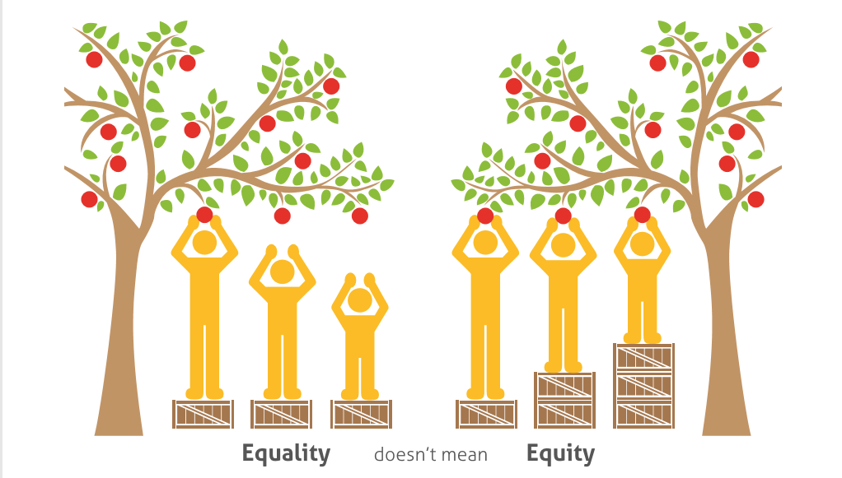
Health Equity: Definition
Everyone has the right to reach their full health potential and not be disadvantaged because of their social, economic, and environmental circumstances.
Permission to use from the Saskatoon Health Region, 2014
Notes:
Equality doesn’t mean equity. Some individuals in our community benefit from additional supports to achieve the same level of health as others in the community. Health Equity ensures everyone has a right to reach their full health potential and is the first step to mobilize change.

Slide 4
The Big Picture:
Consider Factors That Influence Health
The conditions in which people live and the wider set of forces and systems shaping the conditions of daily life are referred to as the social determinants of health(SDoH).
The health of individuals and communities is significantly influenced by interactions
Social, economic, political
Physical environment
Individual behaviors and conditions
Many factors are modifiable at the neighbourhood, community and societal level
Notes:
To mobilize change we have to understand what factors influence health. How do social, economic and political factors influence health? Health equity and the social determinants of health are connected. The conditions in which people live work and play. Individuals, families and communities with low resources are those with the highest disparities. Organizations and decision-makers have the capacity to influence positive changes for example, built environments, transportation, language accessibility, access to services.

Slide 5

Health Equity: Connecting the Social Determinants of Health (SDoH)

Slide 6
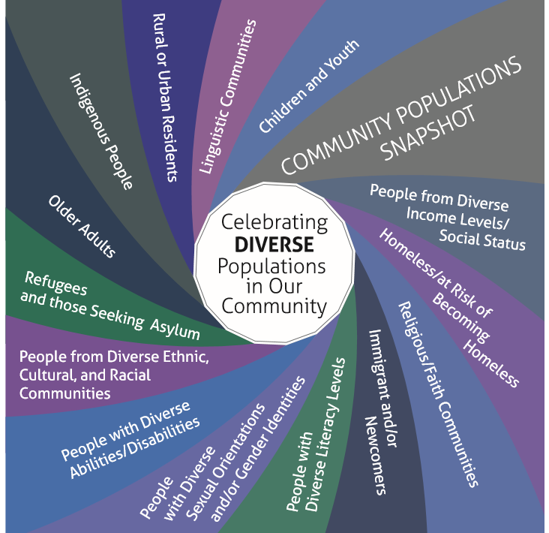
Who are the people in your neighbourhood?
Health equity means recognizing the diversity in your community and to build programs, services, initiatives, and policies that reflect needs of many groups
Notes:
Health equity means looking at the diversity in your neighborhood. These are not all the groups in our community but more of a snapshot of recognizing that services, initiatives and polices have to reflect the needs of many groups.

Slide 7

Recognizing disparities in Canada

Slide 8


Consider Influences:
Social and Environment
Recognize that all income and societal levels, lifestyle choices are informed and influenced by social, economic, environmental and political factors.
The environment in which an individual is raised, lack of resources, access to supports and financial stability affects healthy choices and decisions.
  Fewer opportunities to achieve goals
  Experience more negative life events (unemployment, finances, isolation)
  Chronic stressors trigger compulsive behaviours (smoking, drinking, overeating)
  Leads to increase risk of chronic diseases
Notes:
Income/economics is one factor that affects many of the social determinants of health. How an individual was raised, access to resources, access to supports and financial stability affects healthy choices and decisions throughout an individuals life. Individuals who experience more negative life events, experience more negative outcomes which trigger more unhealthy behaviours such as smoking, drinking, overeating, which leads to chronic diseases.

Slide 9

An individuals health: Chance or choice?
Notes:
So is an individuals health chance or choice? If you have grown up in an environment that is generational poverty your chance of being healthy is less than average. In fact, your postal code can determine how healthy you are going to be.

Slide 10

Consider: The Economic Lens
Connection is well established between income and level of health
Income is significant factor but additional factors exist
Individuals who grew up in under resourced environments may still be living in that condition
Lacking access to supports to develop mental/cognitive skills such as reading, writing and critical thinking
Less access to positive role models and low social capital
Results in stigmas

Slide 11


Considering the Effects of Economics: Health Equity in Your Work

Slide 12
Describing Health Equity-Related Terms
Ability to effectively communicate messages influences how the public and key decision makers think about health, the SDoH and health equity
SDoH:
Opportunities for better health begin where we live,, learn work and play.
All people should have the opportunity to make the choices that allow them to live a long, healthy life, regardless of income
Addressing Health Inequity
Vulnerable Groups/Priority Populations
Giving everyone a fair chance to live a healthy life regardless of their social, economic and environmental circumstances
People who don’t have the same opportunities to be as healthy as others
People who face significant barriers to better health
Poverty
Families who cant afford the basics of life
Individuals living in low income
People who struggle to get by

Slide 13
Population Health Approaches to Tackle Health Inequities/
Disparities
Downstream approaches
Interventions that address immediate health and social needs of populations
Access to and delivery of health services and programs
Reducing barriers i.e. bus passes
Midstream approaches
Interventions that promote healthy environments
Individuals and organizations work towards advocating for improved broader community factors that influence health i.e. the affordable bus pass in Guelph
Upstream approaches
Influenced by broad socio-environmental, cultural, and political structures
Examining underlying systems, policies and values affecting resource allocation

Slide 14

Addressing Health Equity in Dufferin:
Dufferin County Equity Collaborative (DCEC)
The Dufferin County Equity Collaborative (DCEC) represents a strategic partnership of a broad base of stakeholders with a shared mandate to increase social prosperity and decrease inequities for the Dufferin population affected by economic hardship. Working together in collaboration, the membership will jointly set strategic direction, identify evidence informed priorities that can be actioned locally, and capitalize and enhance existing systems and programming.
For more information visit the: DC Moves/DCEC website
References:
Bridges Out of Poverty Framework Wellington-Dufferin-Guelph Public Health 2018
No Barriers Health Equity for All Toolkit and Practical Guidelines For Health and Community Services Providers Windsor-Essex County Health Unit

