Slide 1
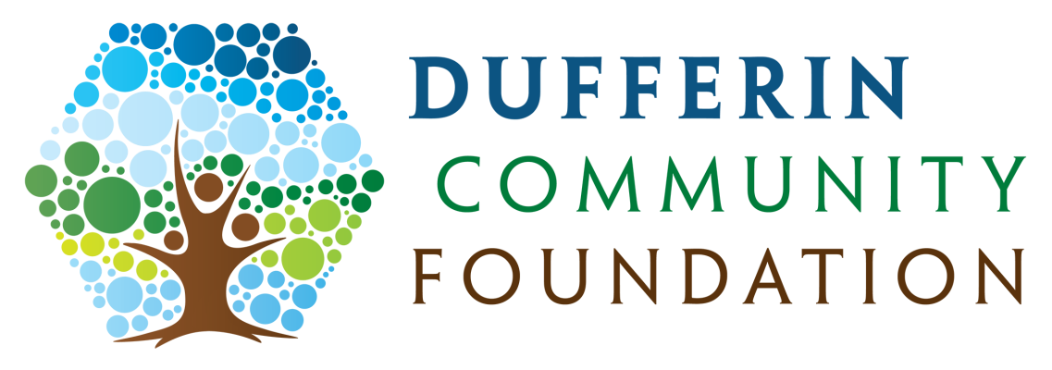
Be part of the Dufferin legacy
The power of many. Today and forever.

Slide 2
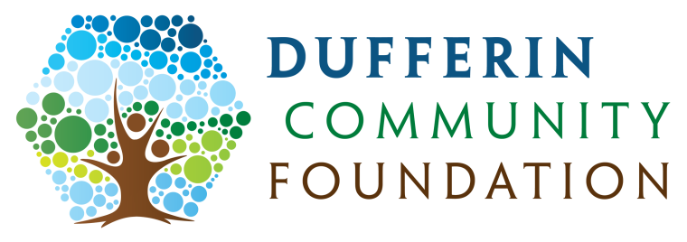
Growing the Dufferin legacy together
The Dufferin Community Foundation was established to create a vibrant community where a “can-do” attitude engages residents, philanthropists and service providers
We connect caring community members to worthwhile causes by
growing endowment funds &
providing responsible grants
that will leave a legacy of enriched community wellbeing in Dufferin County

Slide 3
What is an Endowment Fund?
Invest the capital – original contribution plus any additions - and give away the annual income through a system of grants to qualified charities
Long term sustainable source of funds for community
Major sources of funds for endowment funds are estate bequests, tax planning from sudden one time bump-up in income, e.g. sale of business or disposal of capital assets that attract significant tax

Slide 4
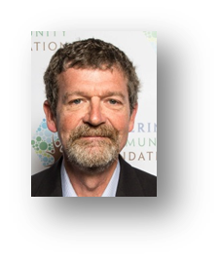
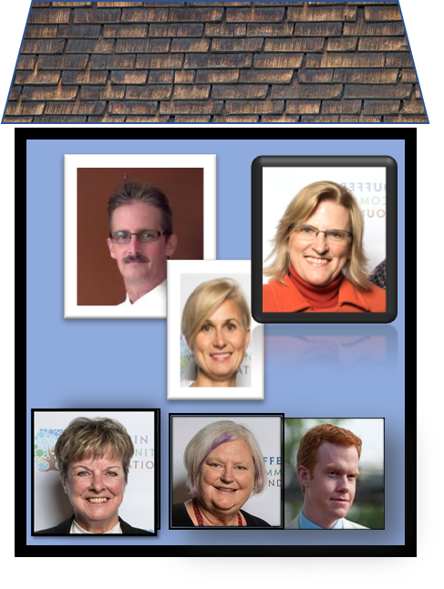
Strong supporters on board!
Executive
Directors
Leaders
Mentors
Government
& Community
Supporters
Notes:
How did we get here? By listening to charities such as yourselves struggle to find annual operating funds, esp since United Way is not well supported in our community. We talked to surrounding CF, we gathered a steering committee together, talked to all kinds of local organizations as well as our local municipal leaders, and over almost 3 years worked on creating our own DCF 0 incorp and charitable

Slide 5
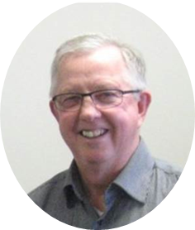
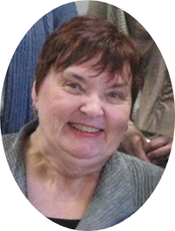
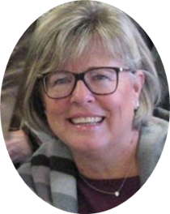
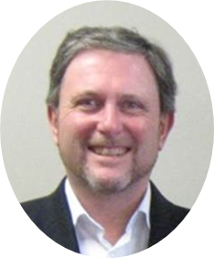
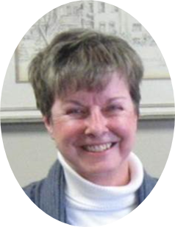
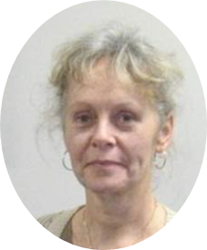
CHOOSE YOUR IMPACT
Steering committee evolved into Board of Directors
-raised funds for start up
Notes:
Created Founders Circle and Corp circle to provide funding for our start up costs

Slide 6
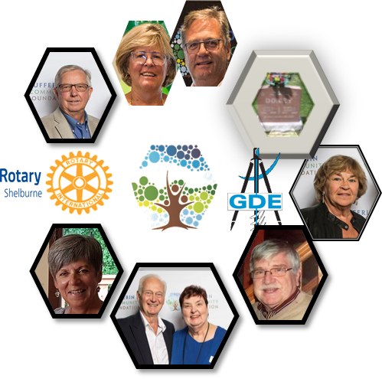
Join the Founders Circle
The Founders Circle is a vital engine for growth. These individuals, families, businesses or community organizations make a financial commitment of $2,500 or more to help the Dufferin Community Foundation pay its operations expenses in the first five years.

Slide 7
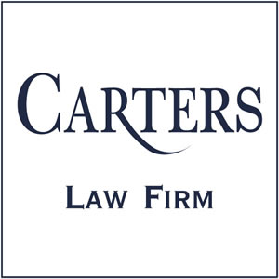
Participate in the Corporate Circle
Participation in the Corporate Circle offers the opportunity to be seen as a community builder. In addition, the Foundation welcomes your advice and goodwill in setting strategy and moving forward.
All donations and sponsorships are gratefully accepted. Minimum donation for inclusion in the Corporate Circle is $5000. Charitable receipts for tax purposes are available.

Slide 8
Seeds sown: 2018 was a great year!
First official Board Meeting in March
Mini-Grant invitations in July
Official Launch at Adamo Estate Vineyards in September
Mini-Grant winners featured on website in October
Official Charitable Status in December

Slide 9
Making an impact through first mini-grants
We asked Dufferin’s charitable community one simple question:
“What would you do with an extra $1000
in the budget for an existing project?”
And they responded – quickly . . .

Slide 10
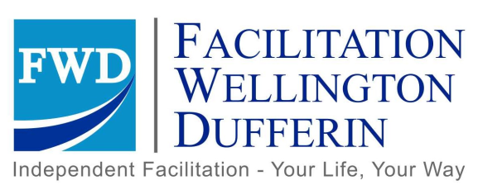
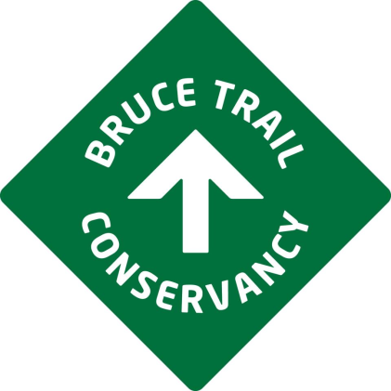
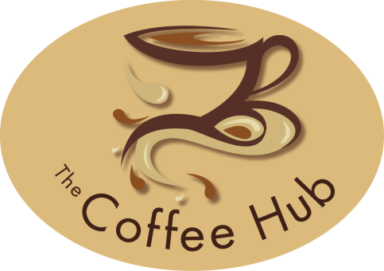
. . . with worthy projects that touch hundreds of Dufferin residents

Slide 11
First Mini-Grant Winners: Bravery Park
Bravery Park, represented by Shannon and Valerie McGrady, received a cheque from Jacqueline Demczur, a partner at Carters Professional Corporation in its Orangeville Office.

Slide 12
First Mini-Grant Winners: Hospice Dufferin
Maureen Riedler, Executive Director of Hospice Dufferin, and Helen Trilesky , a client, received their grant for the Volunteer Visiting Program from Cheryl Greenwood and Amie Zukowski on behalf of sponsor Greenwood Aggregates, the foundation`s first Corporate Circle member.

Slide 13
First Mini-Grant Winners: Dufferin Hi-Lands Bruce Trail Club
Jim Preyde, President of the Dufferin Hi-Lands Bruce Trail Club, a member club of the Bruce Trail Conservancy, received a grant for the Conservancy’s local School Outreach Program from sponsors, Paul and Joan Waechter.

Slide 14
So – What Can the Foundation do for Us?
Foundations provide funding options to charities and similar
Municipal and other government agencies, education etc are charities
Lots of opportunities for partnerships in order to access money
Foundations exist solely to manage money for benefit of charitable activities in the community
Community Foundations by definition distribute funds within their home community
Community foundations promote philanthropy
Community Foundations are a conduit for directing funds from outside source into their community

Slide 15
Mini-Grant Program is back!
2019 Mini-Grants Program are back
Watch for detail on our web site
Sign up for to receive email or social media
Expect applications available July 1
Grants made at September event
3 x $1000 available

Slide 16
DCF in Partnerships with National Partners
New – RBC Future Launch community challenge
RBC and Community Foundations Canada are channeling $15000 to smaller community foundations
Youth 15 to 29 years of age to lead a project – must be partnered with a registered charity or equivalent
“What is your boldest idea to respond to an Urgent Local Need?”
Check our web site under grant seekers – applications now open until September

Slide 17
Federal Announcement
Social enterprises, finance and innovation in Canada gets $22M boost from the federal government
Montreal, June 12, 2019 — Community Foundations of Canada welcomes today’s announcement of $22 million from the new Investment Readiness Program. This investment will allow community foundations and partners from across the country to support local innovation, social enterprise and social financing to tackle some of our most pressing issues like climate change and affordable housing.

Slide 18
What else Can DCF do for us?
Dufferin Vision Fund – general purpose endowed fund to provide grants to area of greatest need in community
Field of Interest funds – donors direct use of funds to specific types of program – arts, scholarships, youth services, community development
Donor Advised funds – donor is part of annual decision making on what grants to fund
Notes:
Donors will direct gifts to funds of their choice

Slide 19
What else can DCF do for us?
Create an Agency Endowed Fund – a free service for local charities
Alternative to setting up your own foundation
Charities are restricted in holding large amounts of cash for many years
Set up endowed fund within the foundation for your sole use
Direct donors who wish to fund long term support of your charity to the foundation
Note difference between annual fundraising and creation of an endowed fund

Slide 20
10 Ways to give
Gifts of cash any time
Give annually for tax benefits
A donation to The Foundation has a more significant impact on your income taxes than an RRSP deduction.
Give a lump sum all at once
Create a personal or family Fund when a larger lump sum becomes available to you. E.g. sale of business
Leave donations to charity through your will
Your gift will be used to create a Fund at The Foundation that will contribute to your favourite causes for generations to come.

Slide 21
10 Ways to give
Gifts of un-used Retirement Funds (RRSPs or RRIFs)
Update the beneficiary on your life insurance to include your charity
Buy a life insurance policy and donate it to The Foundation
Donate stock
When investments are given (not sold beforehand) there is no capital gains tax to be paid and the value of the investment is considered a tax deductible donation.
Use other assets to create a lasting legacy
Real Estate, art and other assets can be discussed on an individual basis.
Give online through Canada Helps

Slide 22
Be part of the Dufferin legacy
The power of many. Today and forever.
To learn more, check out
dufferincommunityfoundation.ca

