Slide 1
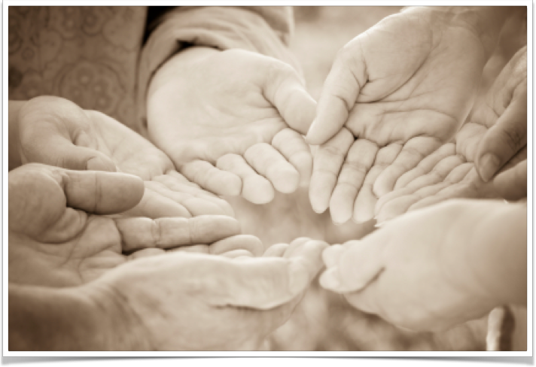
Recreational Respite DC Moves
Lyndsay Gate, Community Team Coordinator

Slide 2
Fun Changes Behaviour! Taking something that is good for your overall social, physical, emotional and mental well being and turning it into something engaging and fun, is therapeutic recreation.

Slide 3
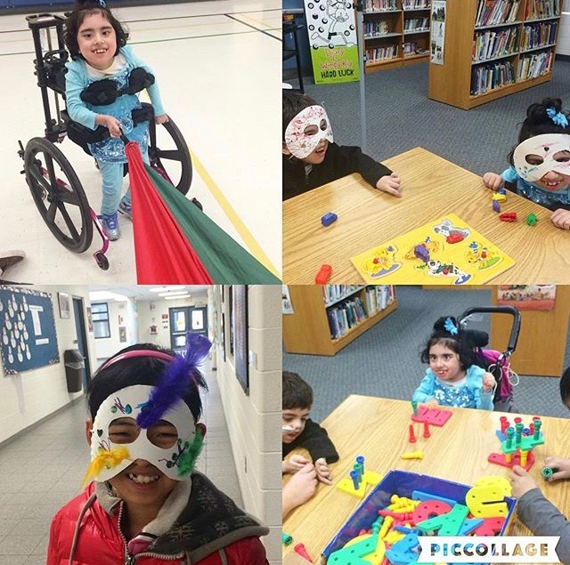
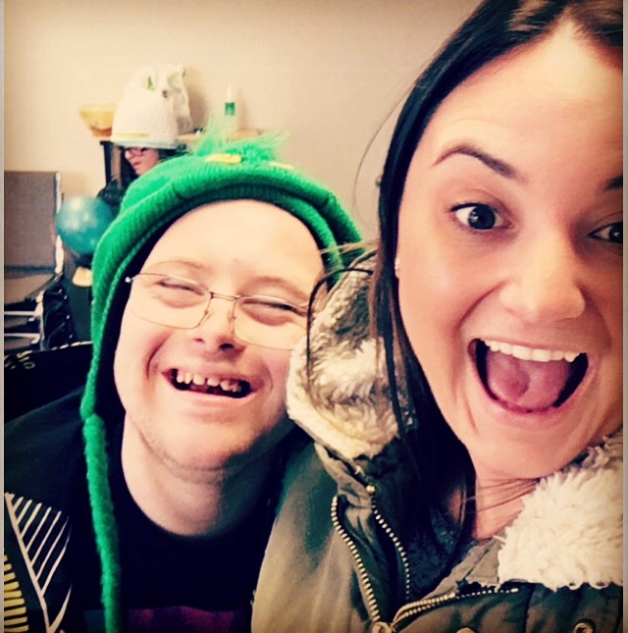
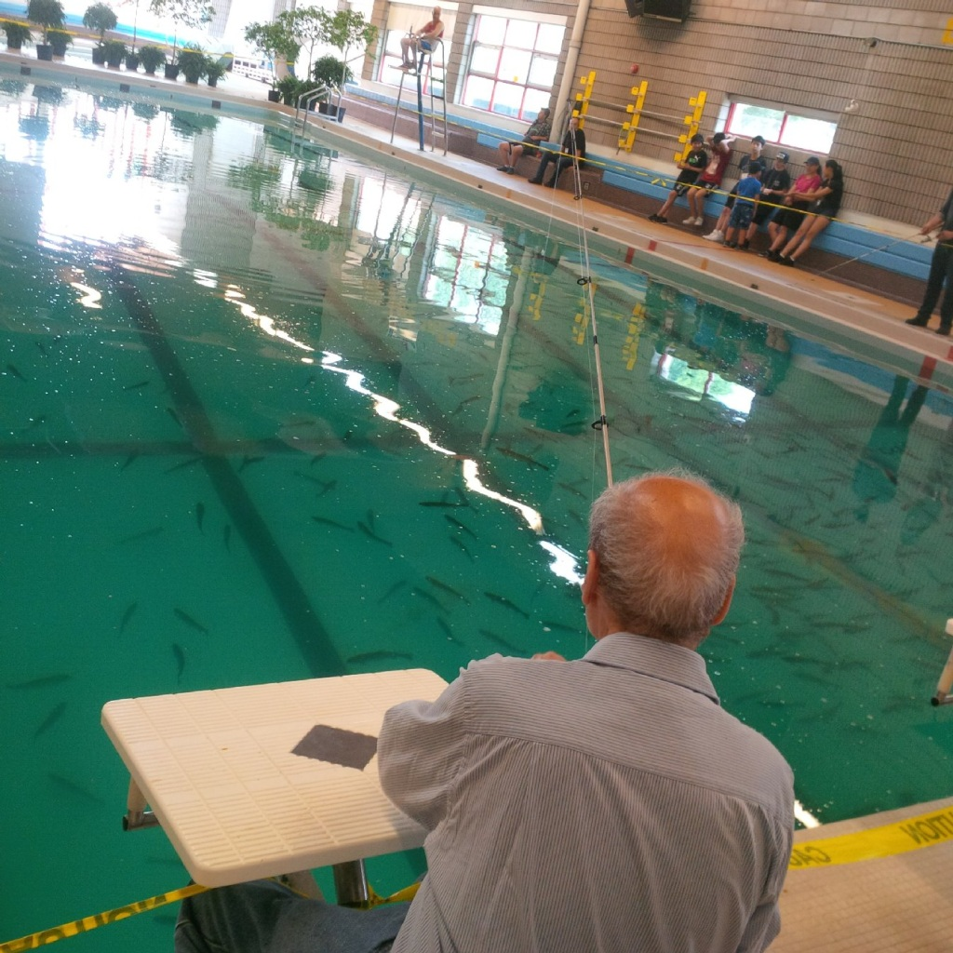
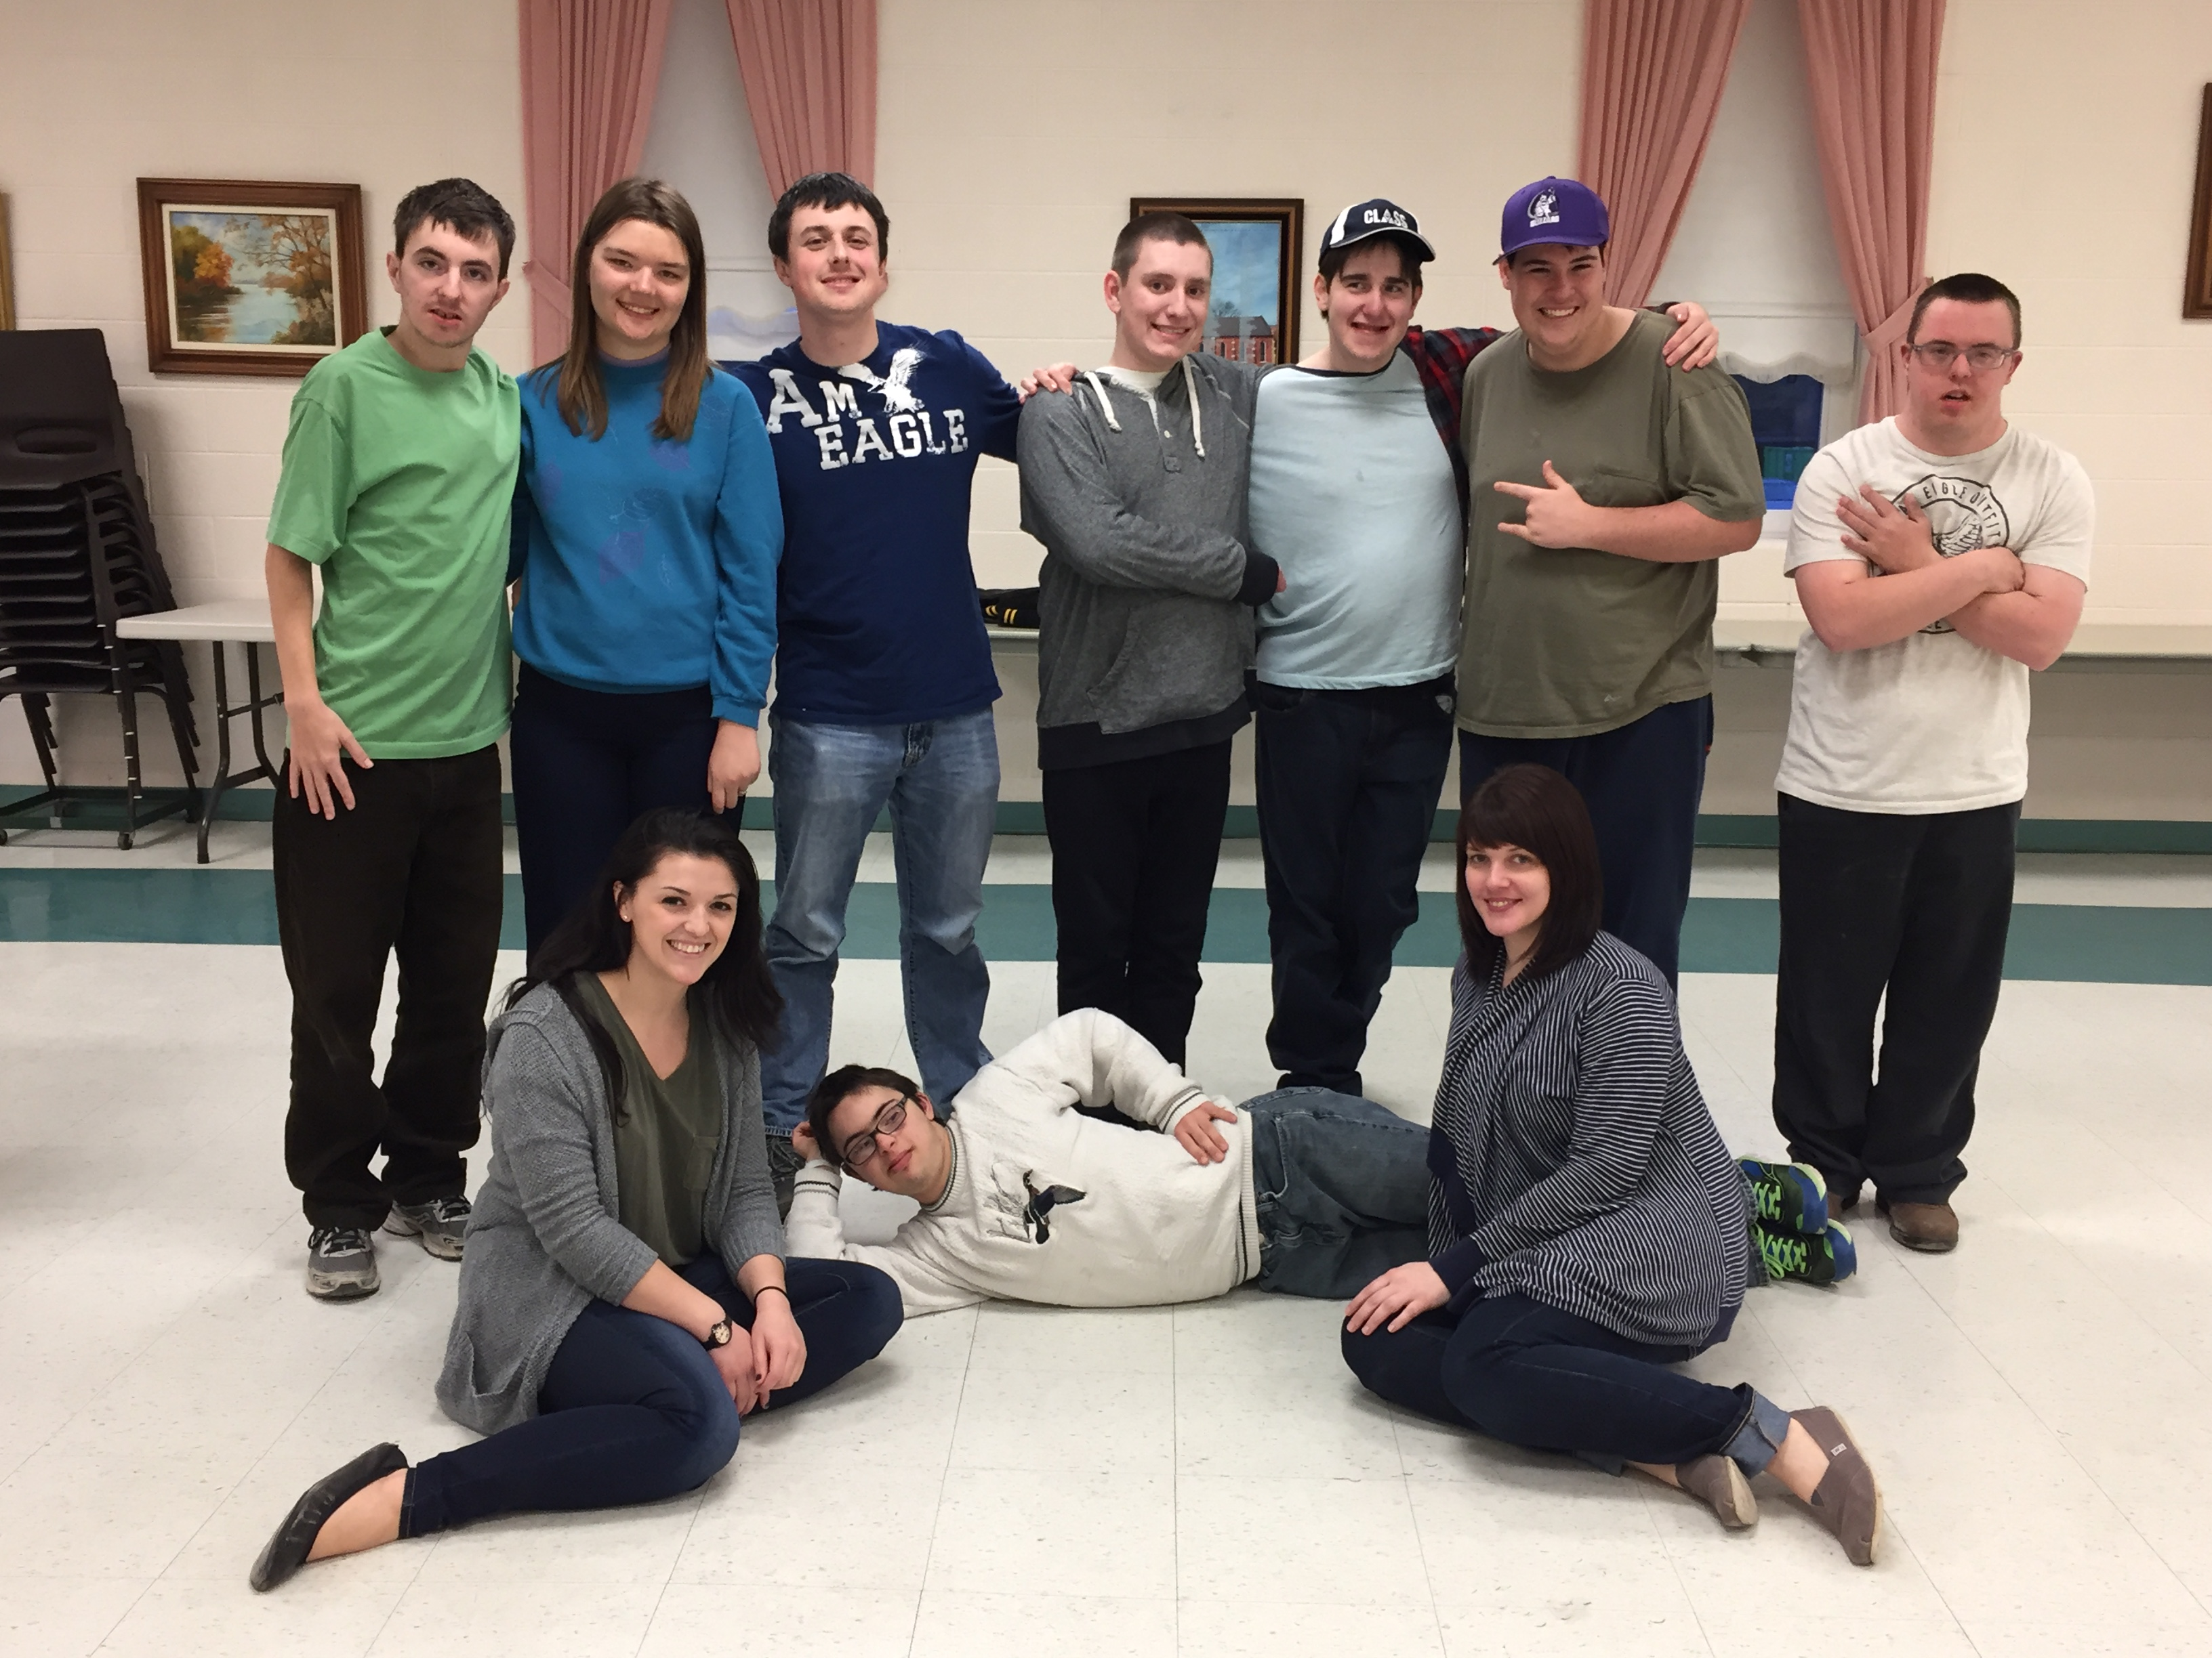
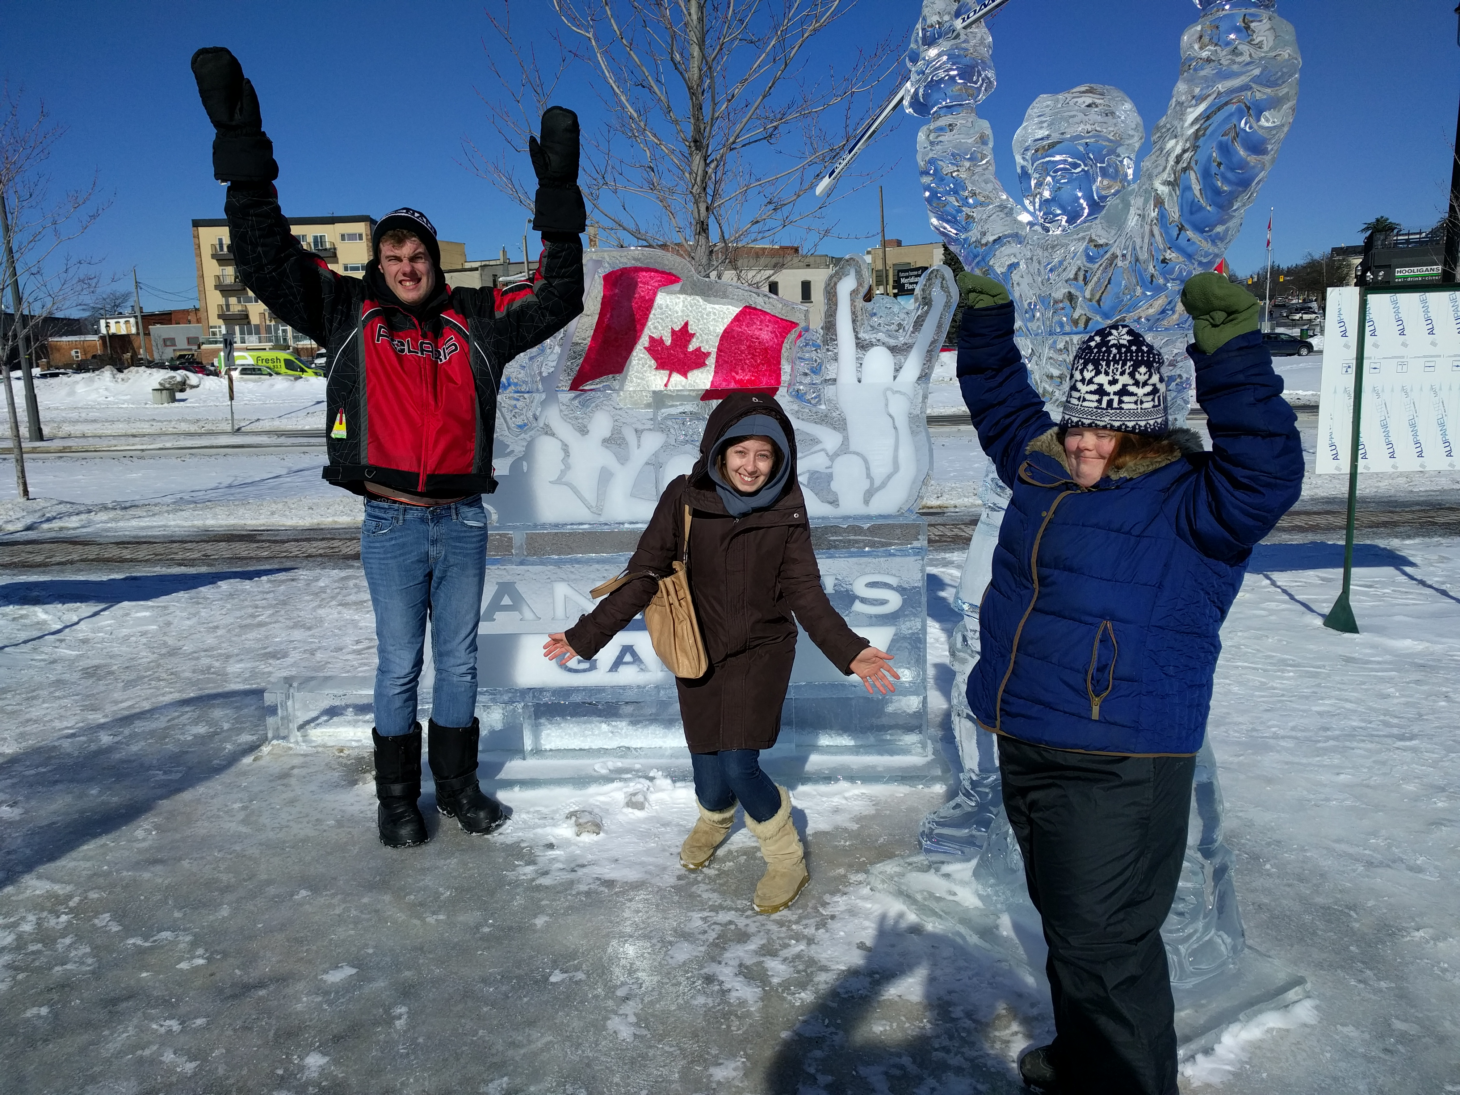
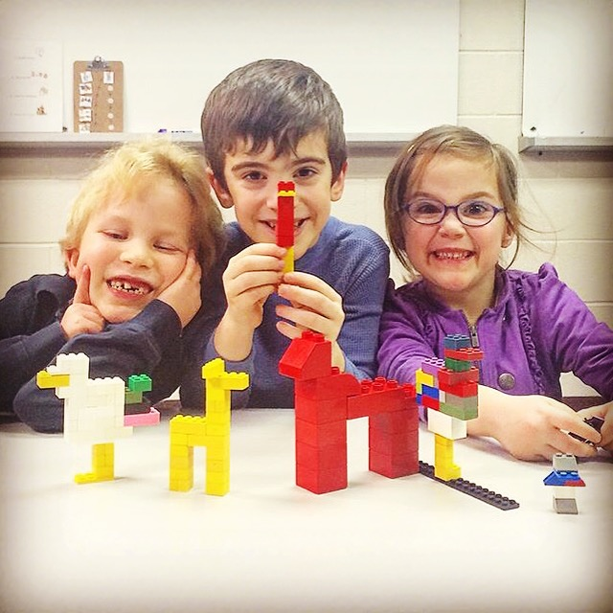
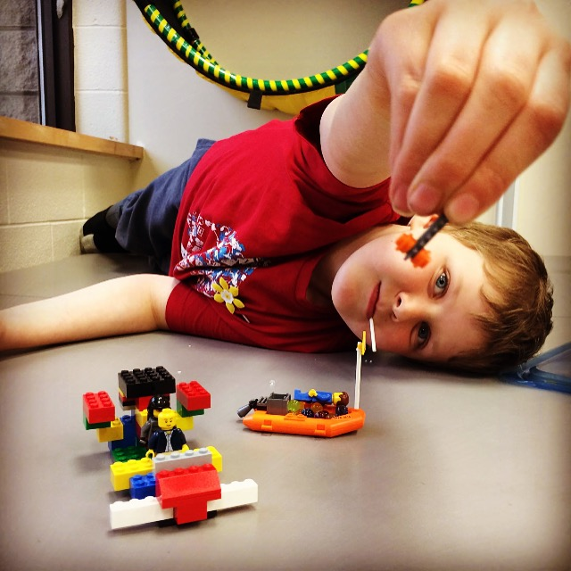
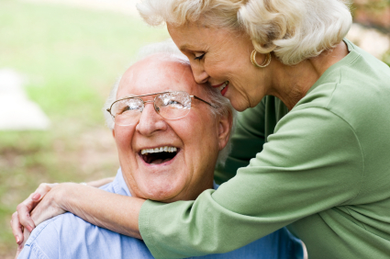
1:1 and Group

Slide 4
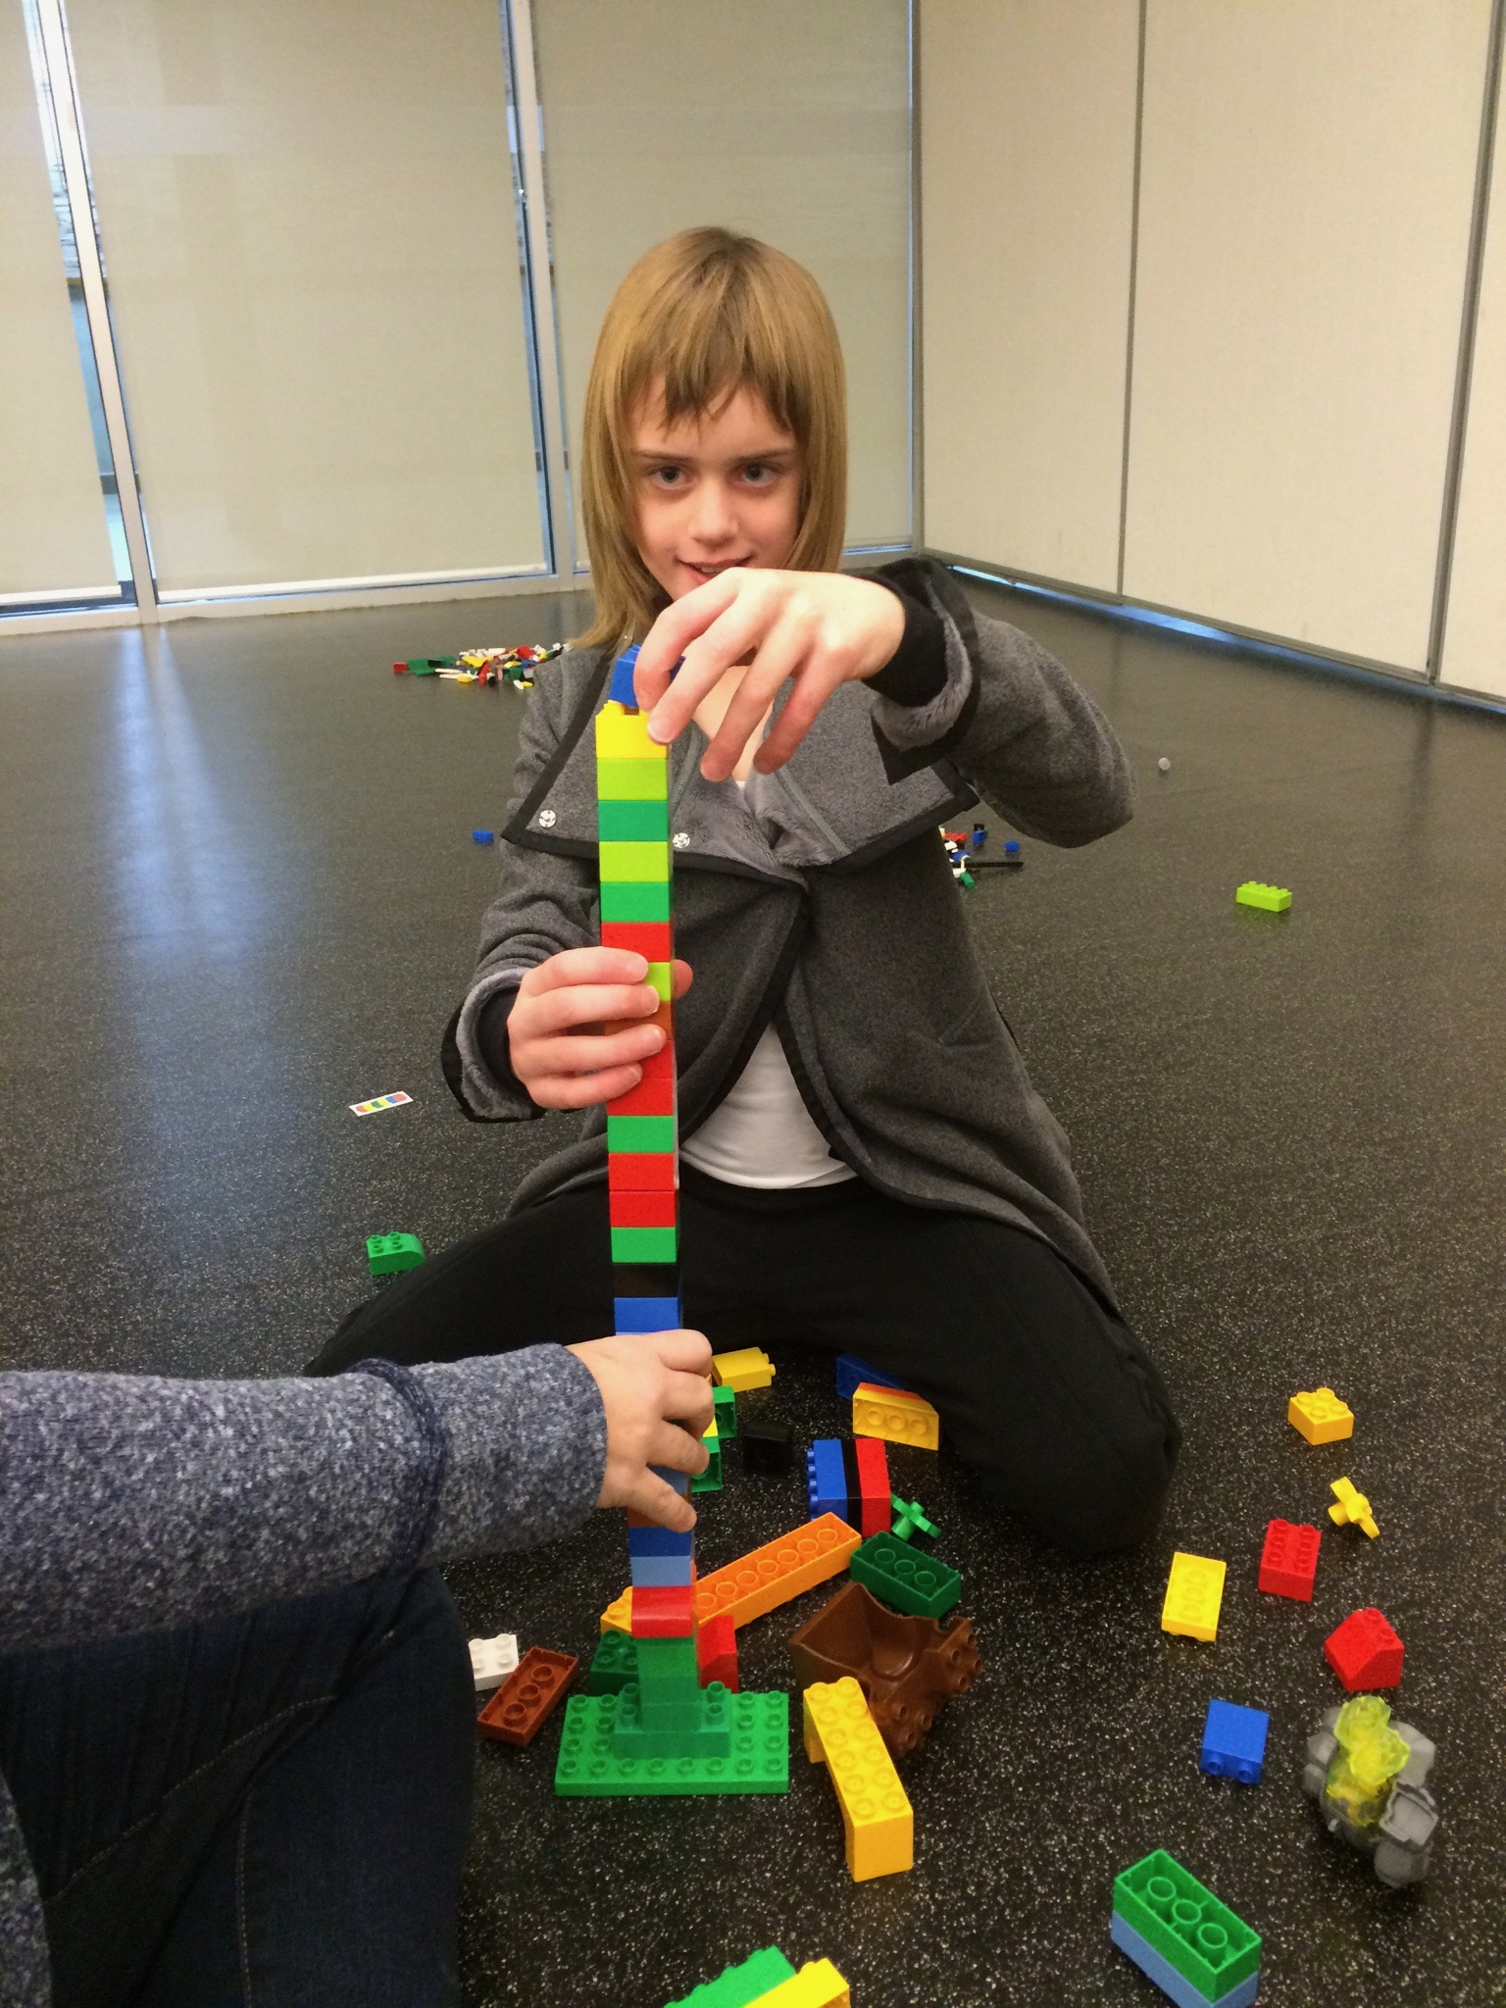
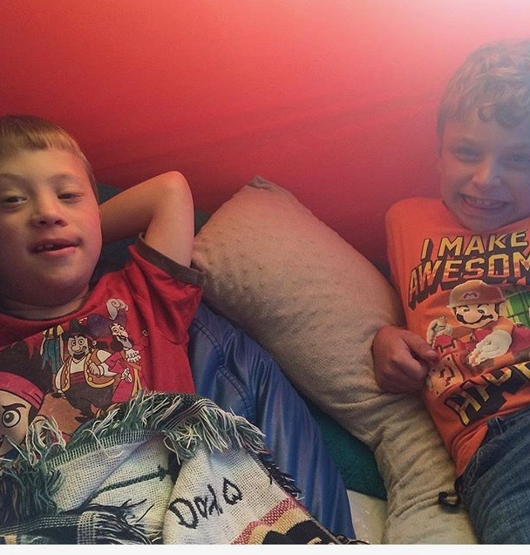
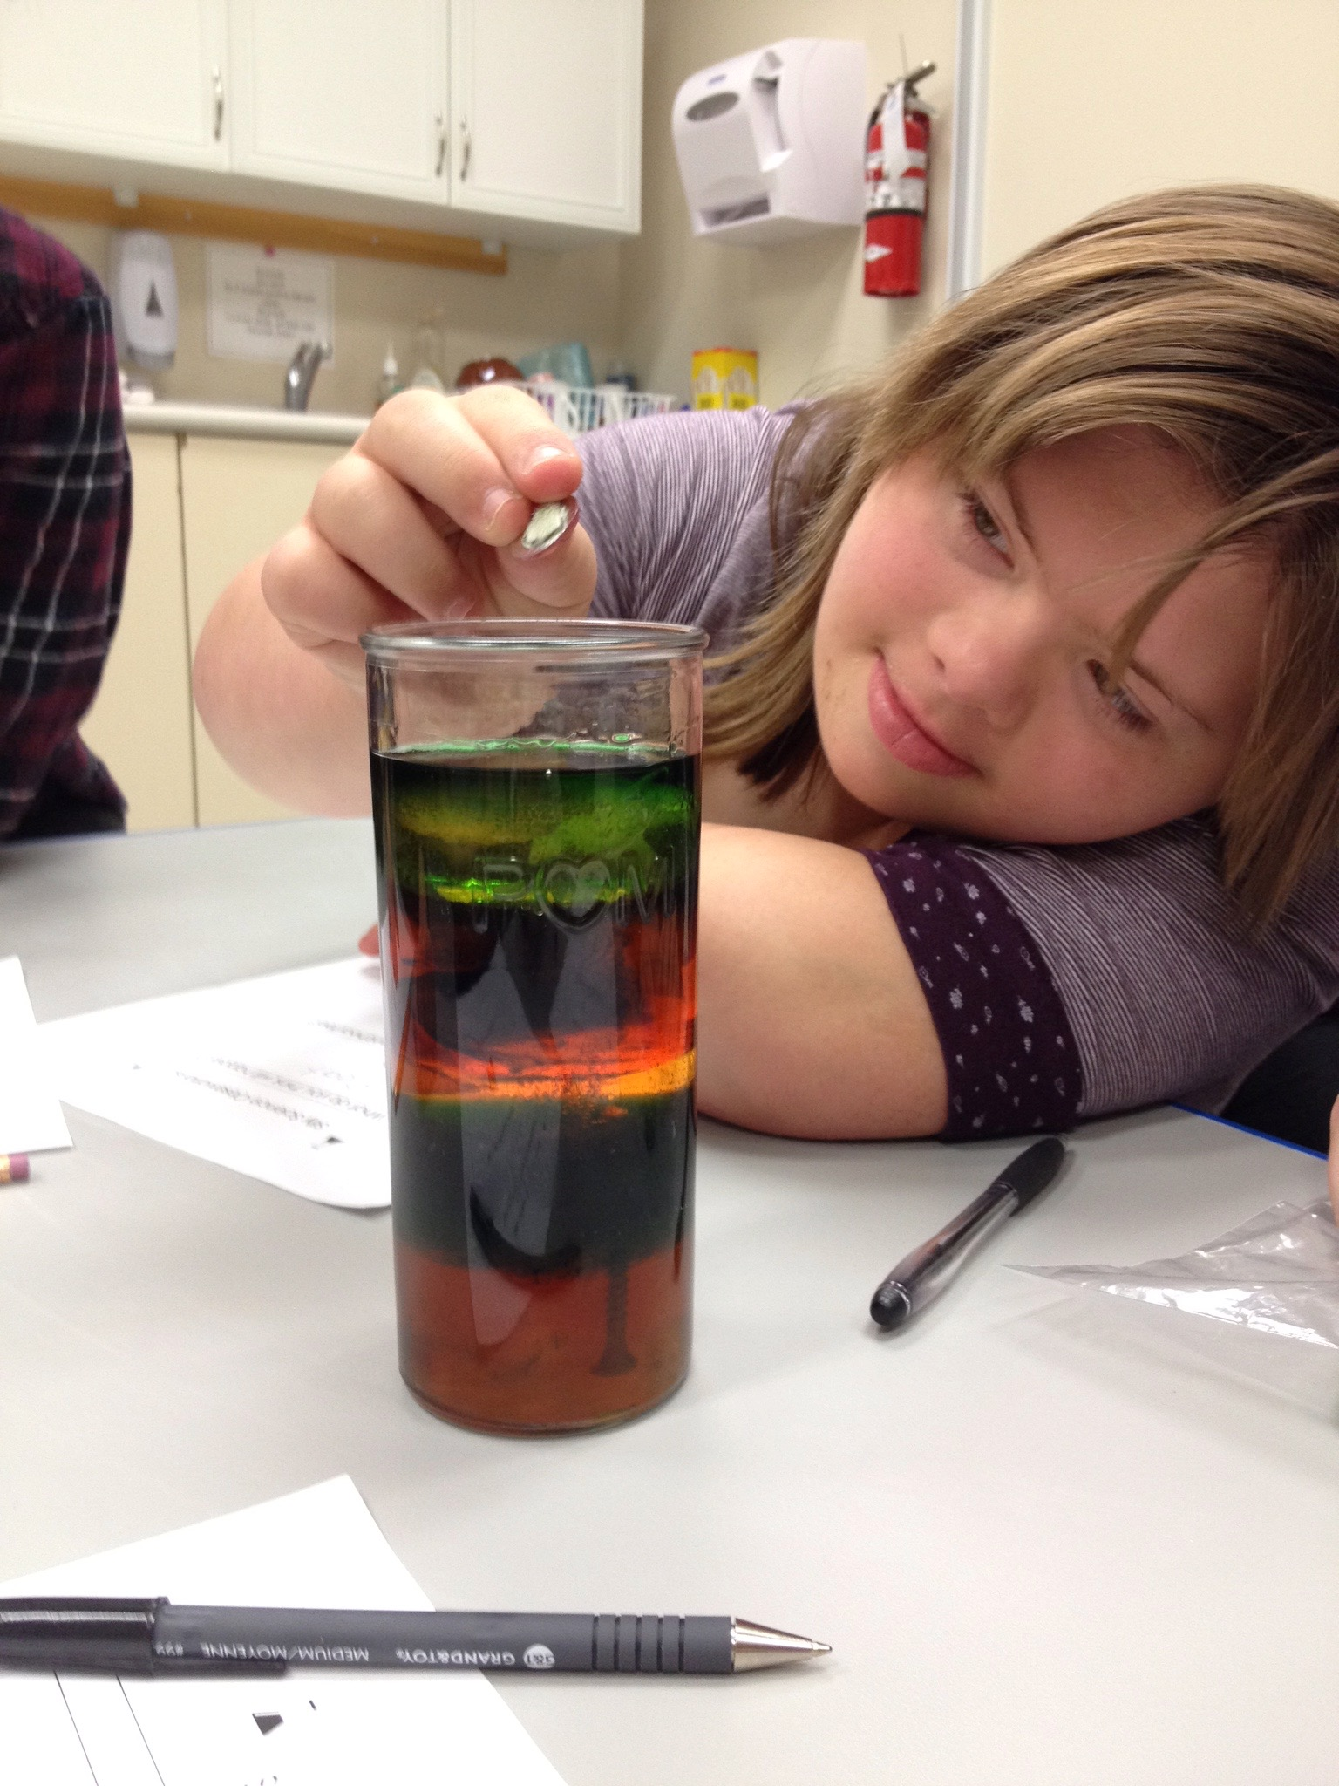
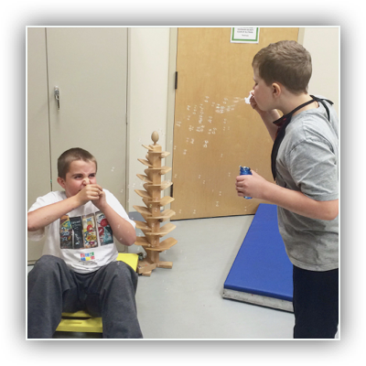
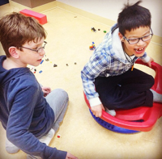
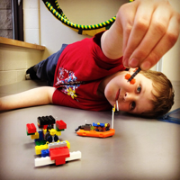
Children and Youth

Slide 5
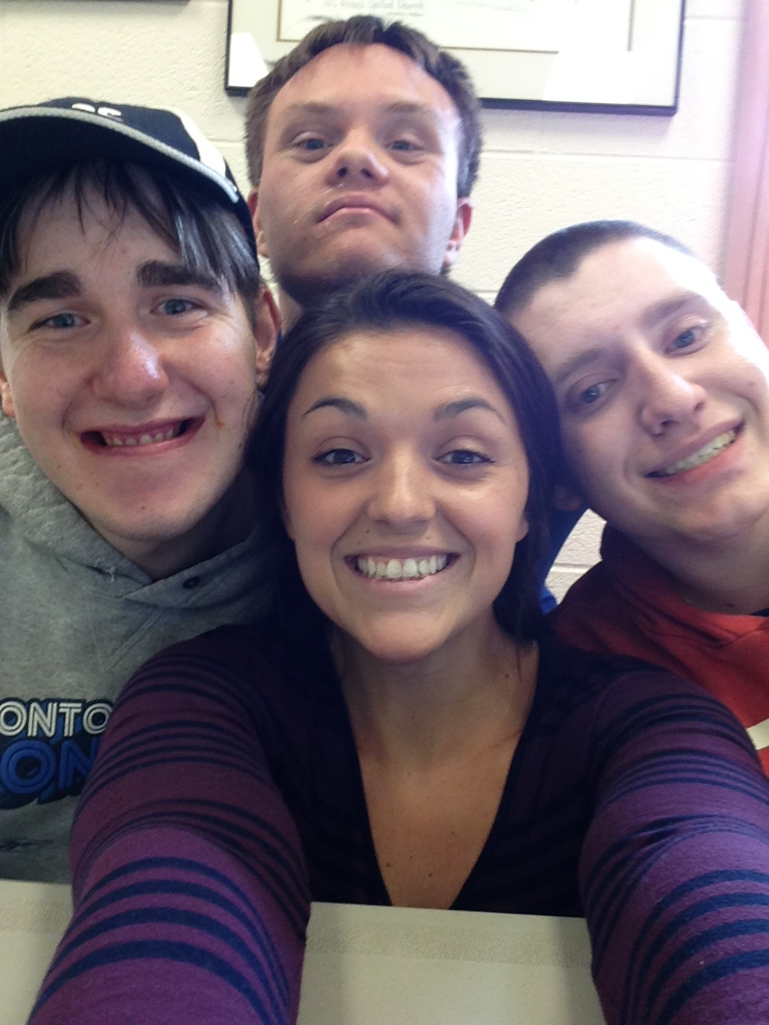
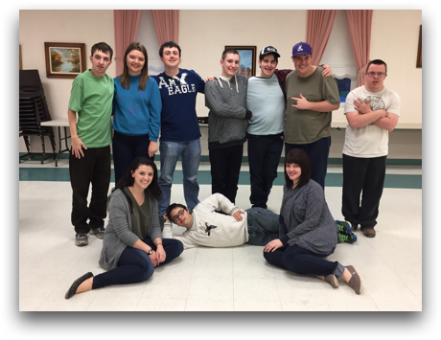
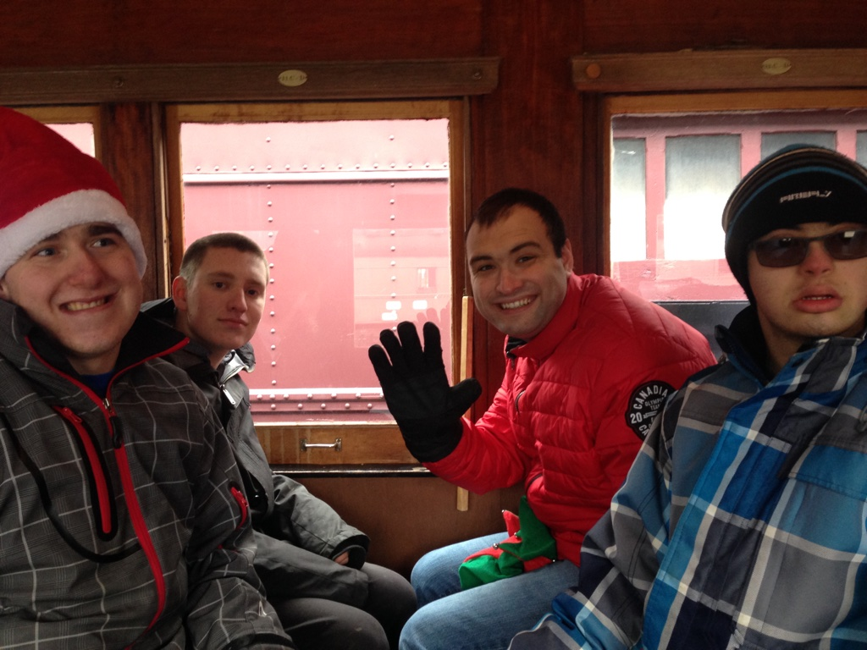
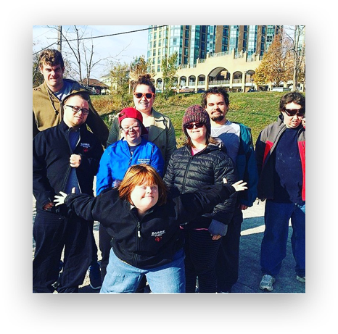
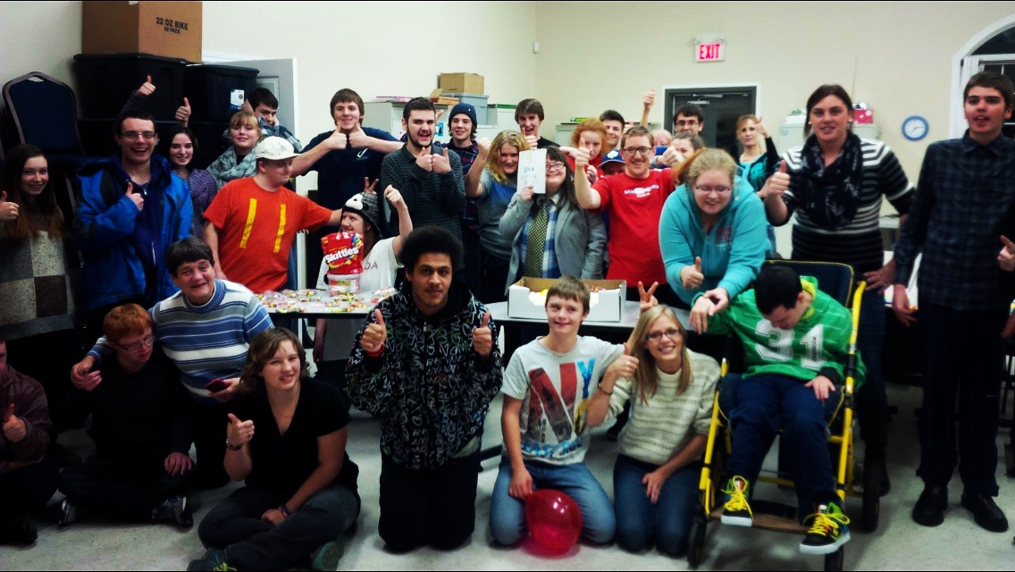
Teens & Young Adults 18+

Slide 6
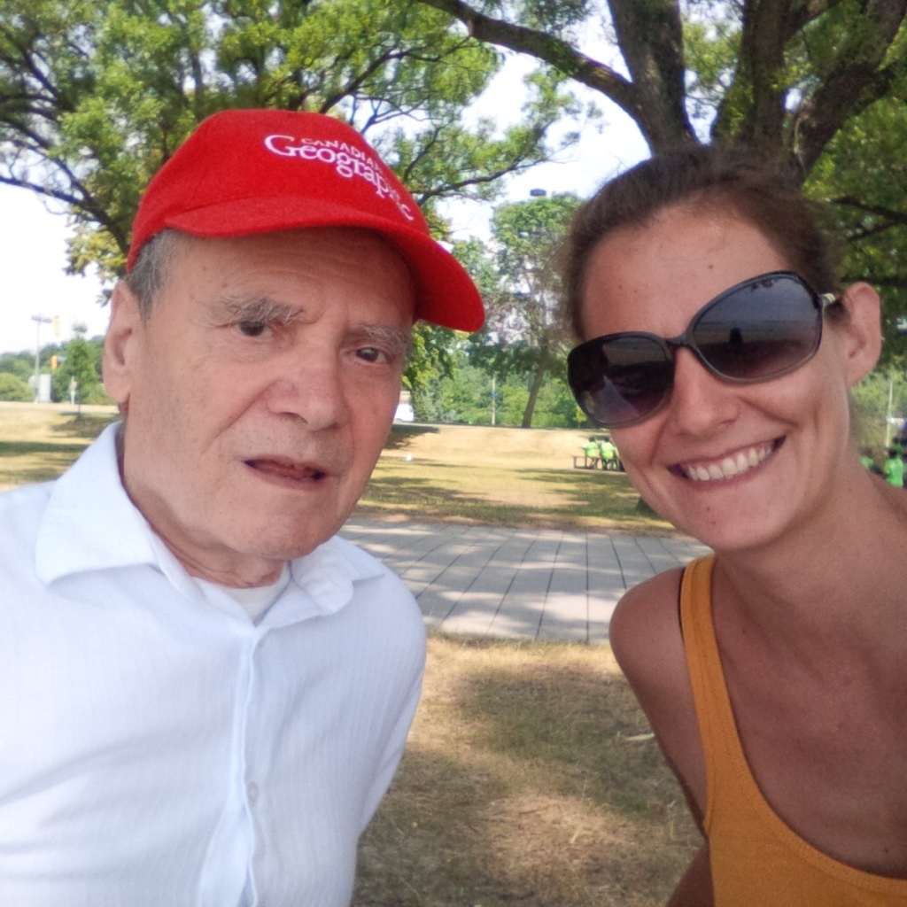
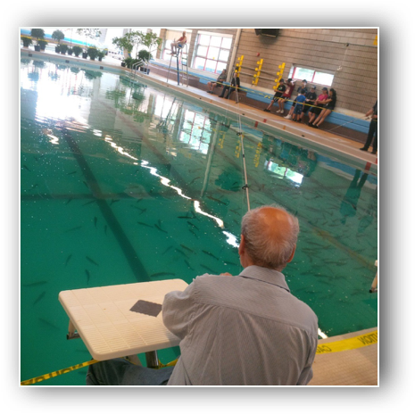
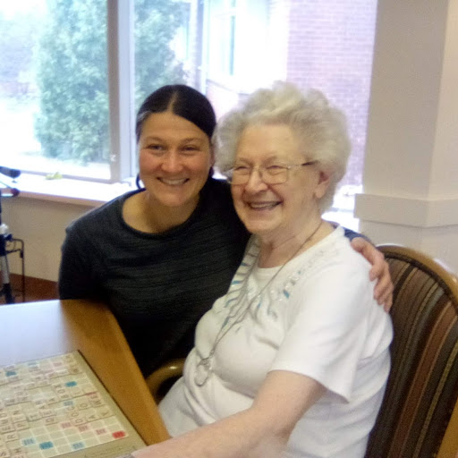
Seniors

Slide 7
PTSD Post Traumatic Stress Disorder
First Responders (and their families)
Children
Youth
Adults
Seniors
Mental Health

Slide 8
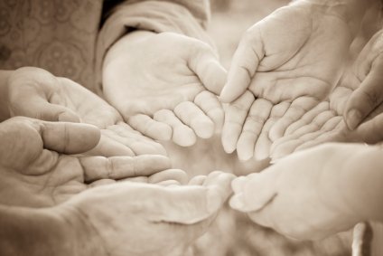
Evolution of Recreational Respite 2008 - Present
1:1 Support
Community Group Programs
International collaborative partnerships with municipal, federal government and non- profit organizations
Crowdfunding partners
Trillium Grant Partners
Health Canada initiatives, First Nations
Research partners (SERC)
App Development
International Advocates and Partners
RecRespite Metrics

Slide 9
RecRespite Metrics
“Measuring impact of community projects in partnership with non profits. Striving for social change and long term sustainability of programs for those who otherwise face barriers to participation.”

Slide 10
Questions?

