Slide 1

HELP STARTS HERE
211 is a nationwide service connecting people to help every year. Simply call 211.
Notes:
- 211 is in its infancy here in Canada, it could be another decade before 211 is as top of mind as 911
In 2001 a CRTC ruling approved the dialing code 211 in Canada
The ruling supported there was a compelling need for 211 to service the broad public interest efficiently and effectively and reduce confusion for the public in finding the right services/contact particularly in urgent situations.

Slide 2

211 – public information & referral services
311 - non-emergency municipal government services
411 - directory assistance
511 – weather and traveler information
611 - telephone company repair service
711 - message relay for telephone devices for the deaf
811 - non-urgent health care telephone triage services
911 - emergency services
Notes:
its important we understand the ruling, use it to partner with a future 811 service
US - NSPL

Slide 3
211:
Easy to remember
24/7
Bilingual
Phone, text, TTY
On-demand interpretation in 150+ languages
Online search, email, chat options
No geographical boundaries
Confidential
Notes:
- What you should know about 211s service delivery in Ontario

Slide 4
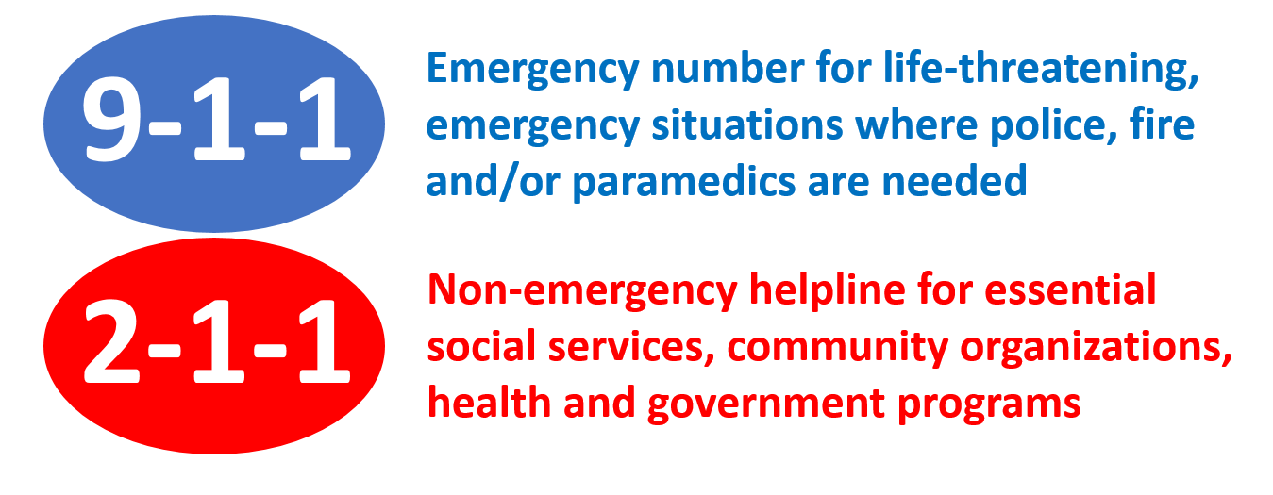
Make the Right Call
Notes:
There is value in ensuring your residents know about 211, which can reduce inappropriate calls to 911

Slide 5
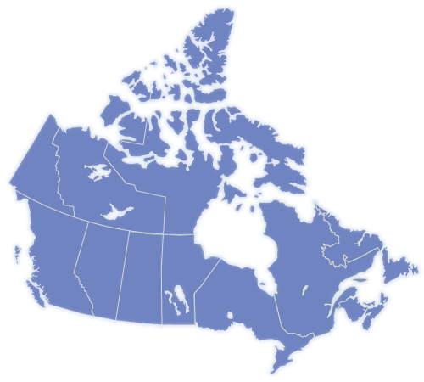
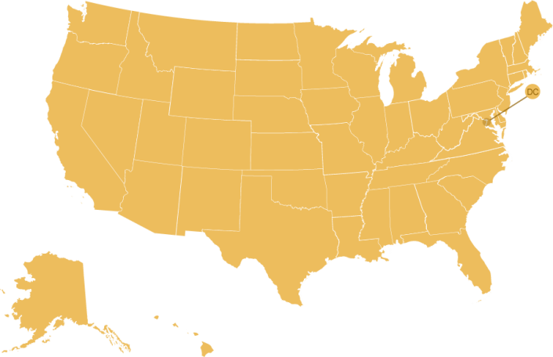

Current Expansion of 211
74% or 26 million Canadians
94.2% or 306 million Americans
Ontario, Nova Scotia and Saskatchewan are province-wide, with expansion efforts underway in all provinces.
Notes:
Expansion in Canada
Expansion in the US directly related to disasters
- AIRS – Standards, Accreditation, Certification, Training

Slide 6
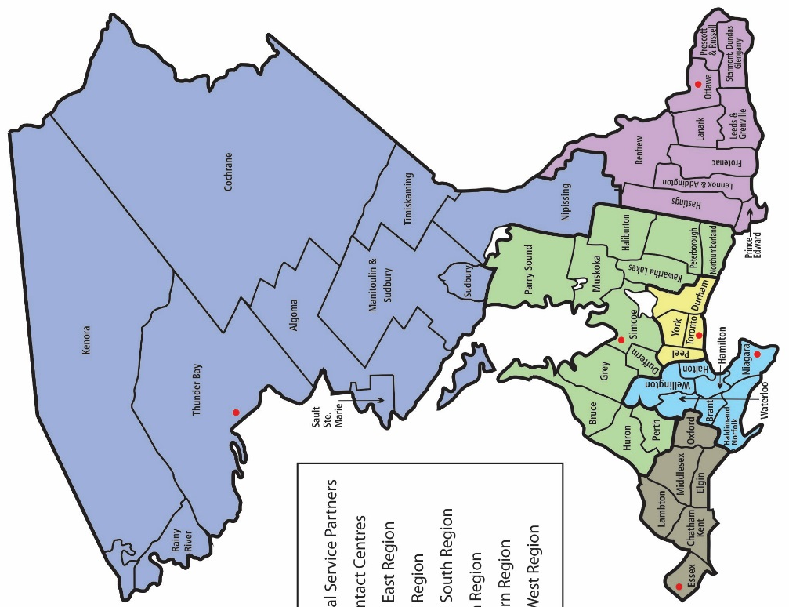
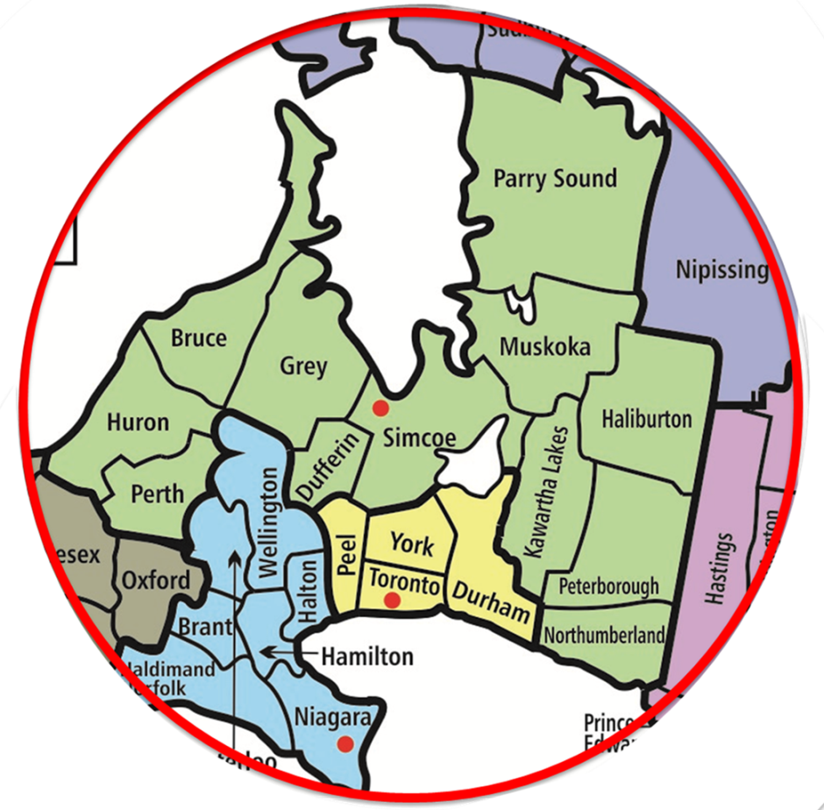
211 Ontario Structure
Six integrated call centres are managed by professionally accredited, independent regional organizations
Ontario 211 Services is the provincial transfer payment agency for the Ontario Ministry of Children, Community and Social Services
Central East Region is managed by
Community Connection in Collingwood
Notes:
Each province and state has a different structure

Slide 7
211 Ontario Technical Infrastructure
Notes:
Our work is enabled with a technical infrastructure
Ontario’s infrastructure is designed to support a future national system
Open data, a single data repository accessible over the Internet
Integrated phone service, cloud-based platform enable on-boarding of multiple phone lines, load balancing & skills based routing
Knowledge mobilization, content management & BI system with access to data, analysis & reporting
211 Online, web platform with access to customized searches, online directories, and unique data sets

Slide 8




Core Service Components
211Ontario.ca
Notes:
It is simplest to think of 211 as having three components

Slide 9

Community Navigators
Trained to conduct an assessment of inquirer’s problems and needs, explain options, provide information and referrals to resources
Advocate on behalf of those who need special support
Conduct follow up in situations where someone is at risk and/or vulnerable
Prepared to assess and meet the immediate, short-term needs of inquirers who are experiencing a crisis
Skilled to answer multiple phone lines and follow customized protocols
* Re-certification is required every two years
  Broader training:
  Crisis Intervention; Suicide Intervention; Mental Health First Aid
  Bridges Out of Poverty
  Difficult populations; Motivating Healthy Behavior
  Housing First; Homelessness Diversion; Housing Instability Acuity (VI-SPDAT)
  First Nations Mental Wellness; Indigenous Cultural Safety Training
  LGBTQ+ Cultural Competency
  Human Trafficking Risk Diversion
  Race and Racism Cultural Competency
Notes:
First bucket

Slide 10



Information & Referral
Advocacy
Unmet
Needs, mental health needs, at-risk callers offered
follow up
Information & Assistance
Divert unneeded calls to (multiple) service agencies
Needs
Assessment
Resolve problem, ensure caller understands next step(s)
Information Provision
Service
Quality
Surveys
Hello, Bonjour. How can I help you today?
Referrals; Follow protocols tailored to local agencies & crisis lines (e.g. intake, warm transfer); Conduct follow-up with callers, care coordinators, navigators
Follow-up Program
24/7 – Live Answer – Multilingual – Online Chat - TTY

Slide 11
Data Curators
Manage a province-wide inventory of community, social, health and government services, including details about the services provided and the conditions under which they are available
Contact all listed organizations and programs at least annually to update their information
Continually monitor news and social media for changes and additions to services
Create and maintain custom data sets to meet local needs
Use technology tools to share community resource data
Use custom software to create online directories on local topics or service needs
* Re-certification is required every two years
  Broader training:
  Inclusion/exclusion criteria
  Mandatory & recommended data elements
  Taxonomy classification system
  Content management & indexing
Notes:
Second bucket

Slide 12
Community Resources
 | Dufferin County | Central East 211 Region | Ontario
Agencies | 87 | 5,591 | 30,591
Sites | 113 | 7,705 | 45,973
Programs | 162 | 9,279 | 60,003

Slide 13

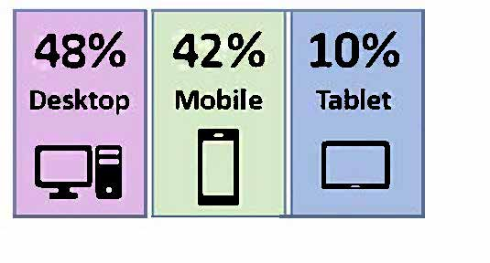
2018 Online Access to
Community Resources
Total Sessions
211CentralEastOntario.ca: 1,142,751
(includes all websites, online directories and
Google searches with database listing results)
Traffic Sources:
User Devices:
1,008,153
Organic
85,688
Direct
46,349
Referral
2,515
Other
Note: A session is a group of user interactions with a website within a given time frame. Organic traffic comes from search engines. Direct traffic comes from typing a specific URL. Referral traffic comes from other URLs.

Slide 14
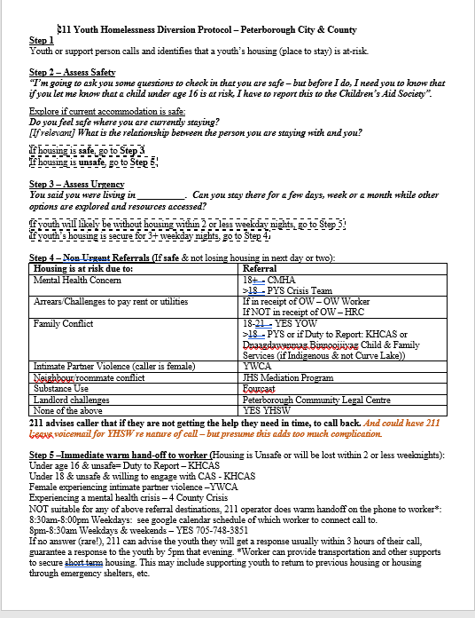
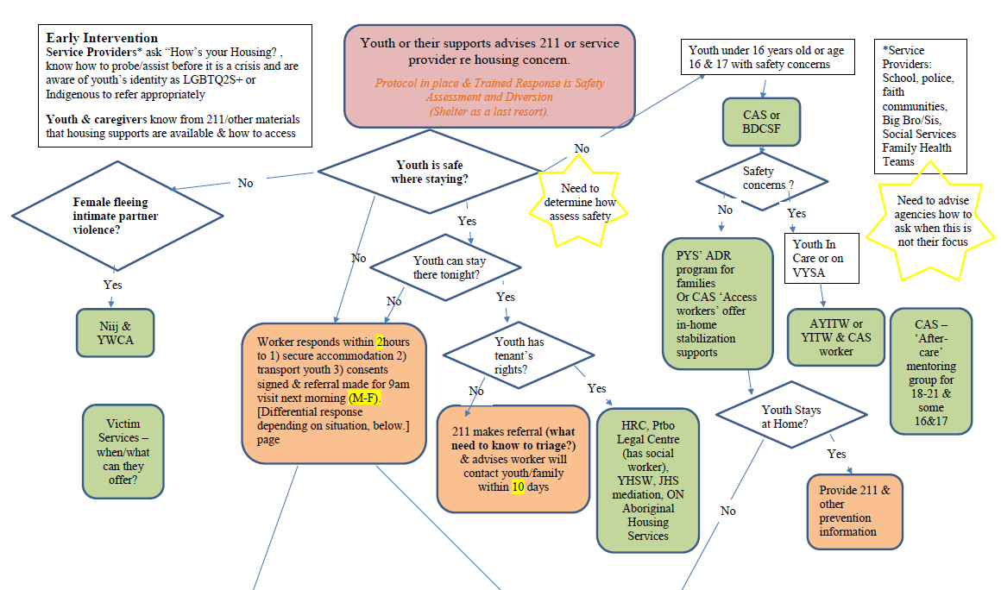
Protocol Example

Slide 15
Data Analytics & Business Intelligence
Produce reports with aggregate information about caller demographics, service needs, advocacy and follow up details that demonstrate community needs and trends
Produce reports on unmet needs and service gaps which can inform community investments and service planning
Use a data repository which enables sharing of community resource listings in multiple formats and custom online directories development
Produce reports on multi-channel access (e.g. chat, text, email, call-back service), and performance data (abandoned calls, wait time, talk time)
  Data reporting:
  System mapping
  Community needs assessments
  Community planning
  Research
  System performance

Slide 16


2018 Regional Contacts
Total Contacts: 30,009
(120 per work day)
(577 per week)
(2,500 per month)
Central East Region
2018 – SNAPSHOT
#1 Health
#2 Housing
#3 Individual/Family Services
#4 Legal
#5 Government
#6 Mental Health/Addiction
#7 Utilities
#8 Transportation
#9 Specialized Information Lines
#10 Financial Assistance
Community Navigators:
26,434
Referrals
made
30,009
Contacts received

Slide 17
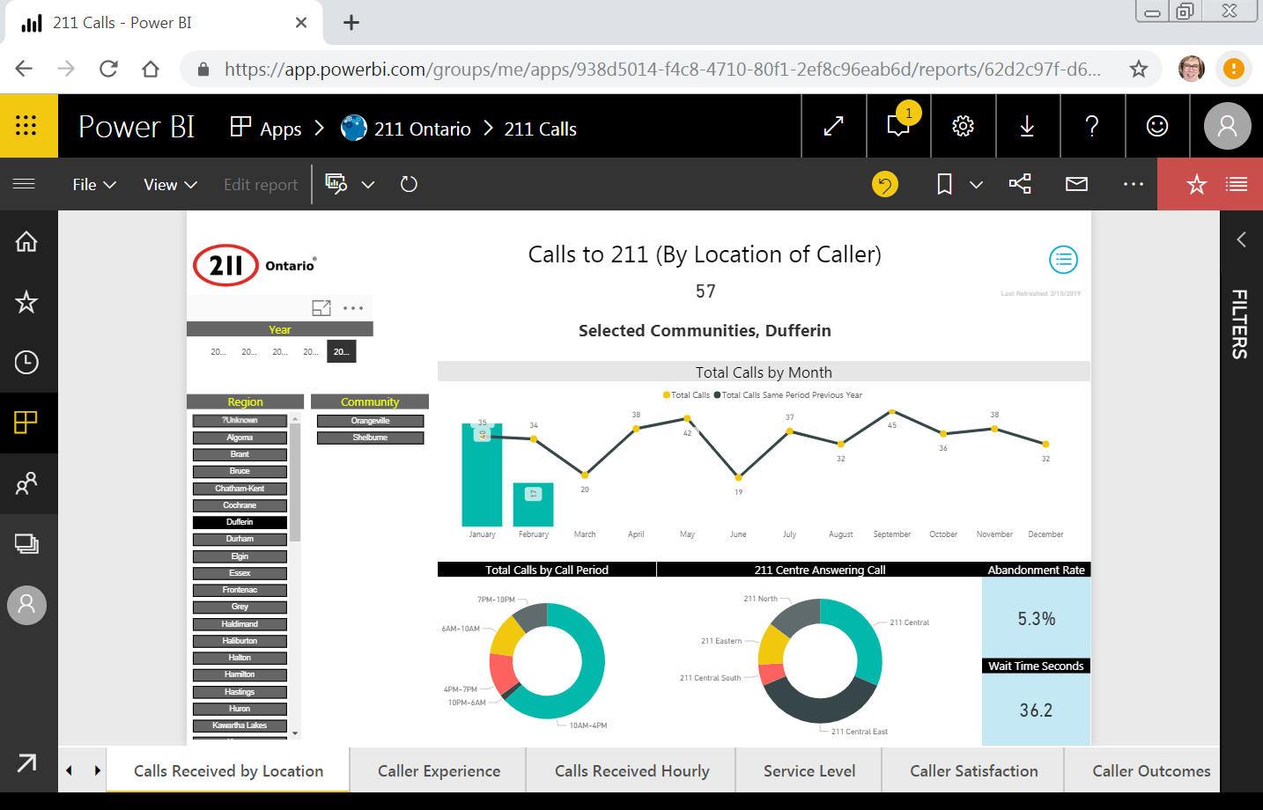

Slide 18
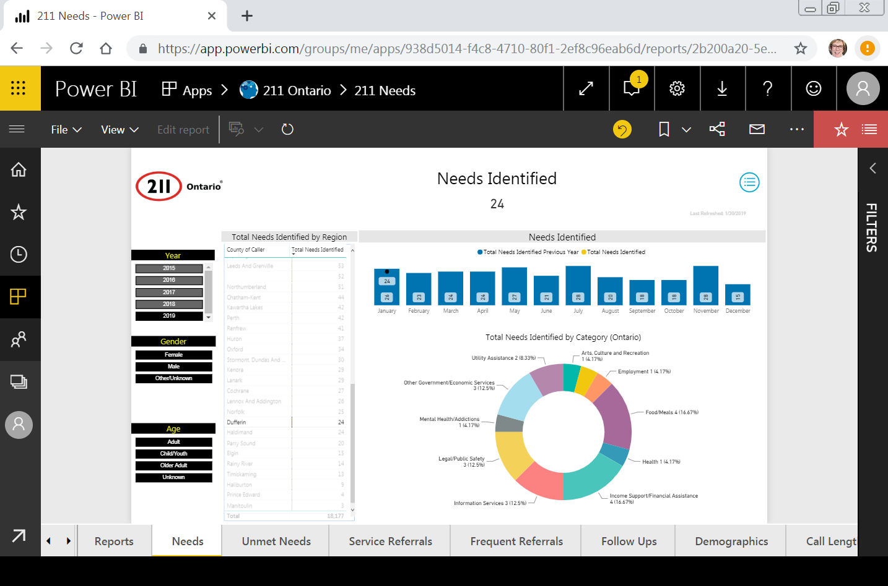

Slide 19
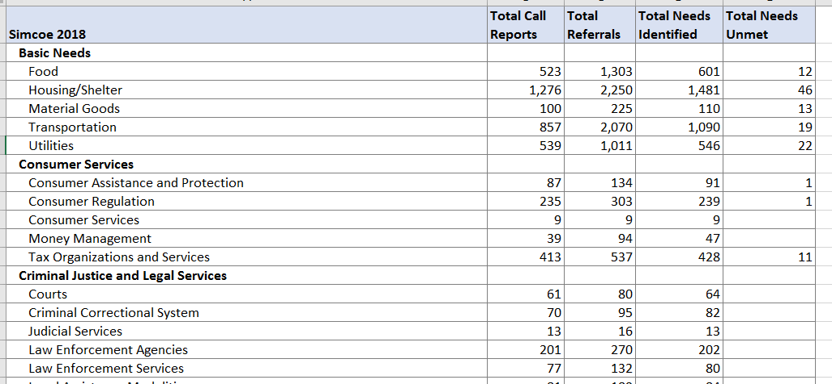
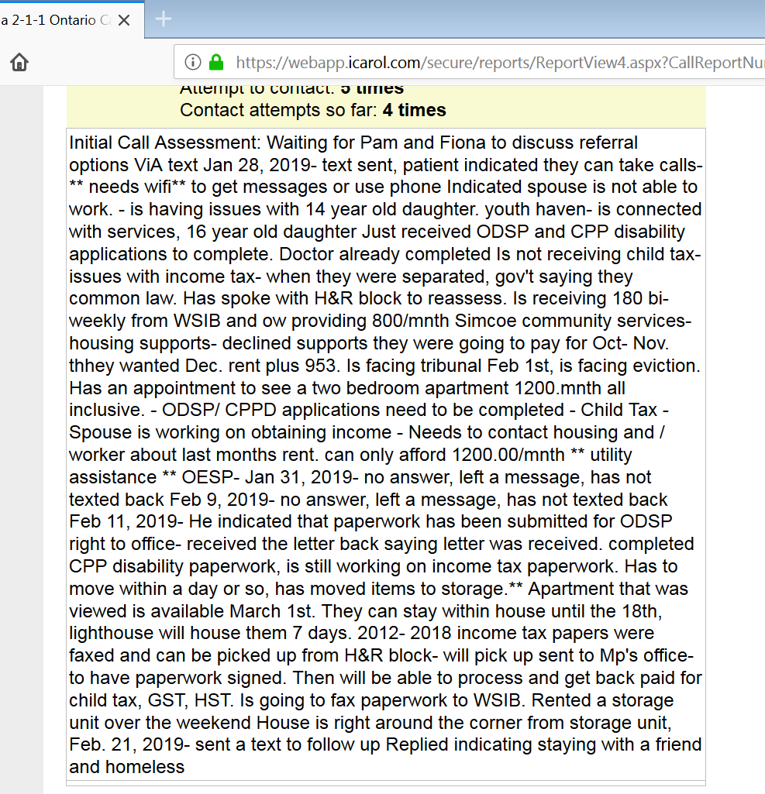
2018 Simcoe County | Total Call Reports | Total Referrals | Total Needs Identified | Total Needs Unmet
Basic Needs (food, housing, goods, transportation, utilities) | 3,084 | 6,021 | 3,828 | 112
Individual & Family Life (support services, leisure, spiritual, volunteer) | 1,773 | 3,864 | 2,298 | 39
Organizational/Community Services (arts, facilities, groups, government offices) | 1,872 | 3,141 | 1,993 | 14
Health Care (emergency, general, labs, rehab, treatment, prevention) | 1,693 | 2,938 | 1,879 | 36
Criminal Justice & Legal Services (courts, law enforcement, legal services) | 888 | 1,452 | 1,025 | 5
Mental Health & Substance Use (assessment, treatment, supports & services) | 748 | 1,426 | 924 | 14
Income Support & Employment (employment, public assistance, social insurance) | 782 | 1,487 | 866 | 29
Consumer Services (protection, regulation, tax services) | 778 | 1,067 | 814 | 13
Environment & Public Health/Safety (public health, environmental protection) | 119 | 215 | 122 | 4
Education (schools, programs, support services) | 97 | 167 | 102 | 4
Totals | 13,095 | 15,778 | 13,851 | 270
Notes:
We determine a need to be unmet when we cannot find a suitable community referral to give the caller. This can happen for a number of reasons, including:
No service/program exists in the region of the inquirer
Inquirer is ineligible for service/program
Service or program is full or has waiting list
Hours of the agency do not meet the needs of the inquirer
Agency or program resources are depleted
Inquirer unable to reach the agency/program
Inquirer cannot afford the service
Inquirer has no transportation
Language barrier

Slide 20
211’s Value Proposion
Short term outcomes:
Immediate connections to urgent needs such as food or meals, financial assistance, shelter services, as well as potentially crisis intervention or diversion programs (IE homelessness, human trafficking)
Longer term outcomes:
Connections to broader interventions such as parenting skills, tax credits, budget counselling, violence support services, mental health walk-in clinics, stress management, child development programs, positive social activities, education or learning opportunities, employment /training opportunities
Decreasing the burden on other systems both from the viewpoint of the public trying to access services and for each individual organization trying to properly field and direct inquiries
Systemic outcomes:
Data and reporting capabilities provide community planning data relating to both the demand and supply of human services, and can identify service gaps and overlaps, and trending needs
Data and reporting that measure the effectiveness of 211s intervention can identify barriers and service gaps that result in unmet needs provide an opportunity to bring partners together to work on potential solutions
Notes:
A summary of our value proposition

Slide 21
211 – A Shared Services Partner
211 Brand
Human Resources
Technical Infrastructure

Slide 22









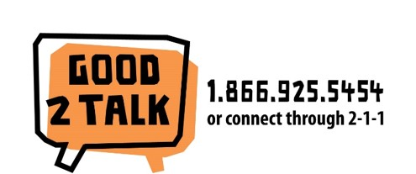

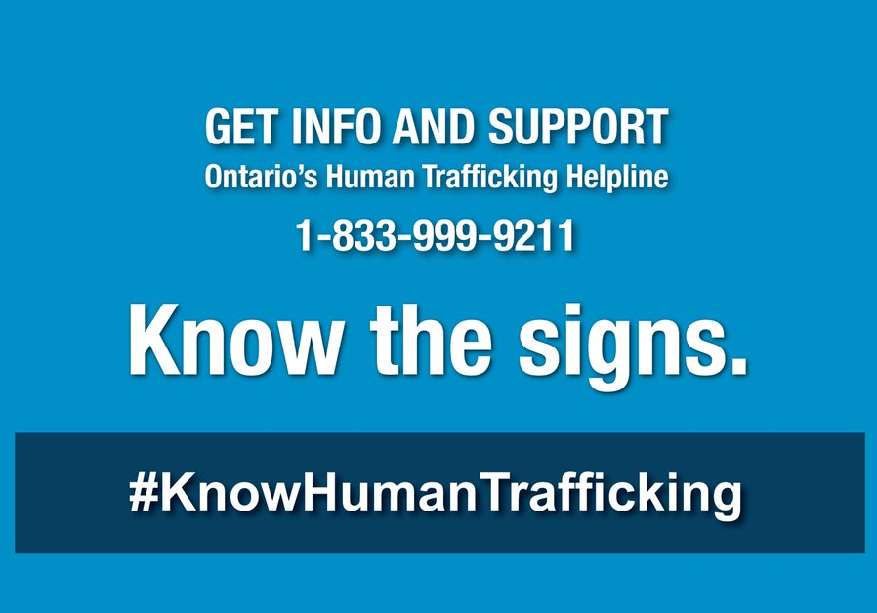

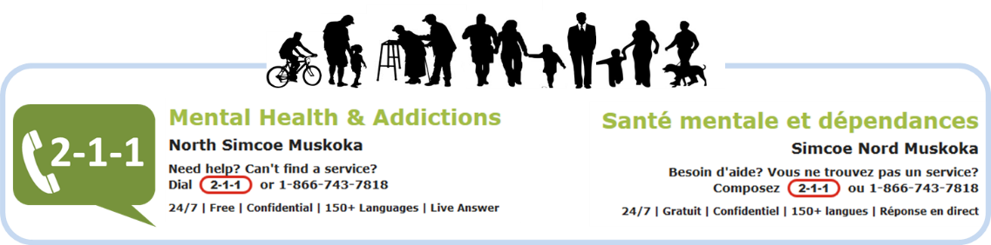
Notes:
We have deep and expansive partnership across many sectors

Slide 23




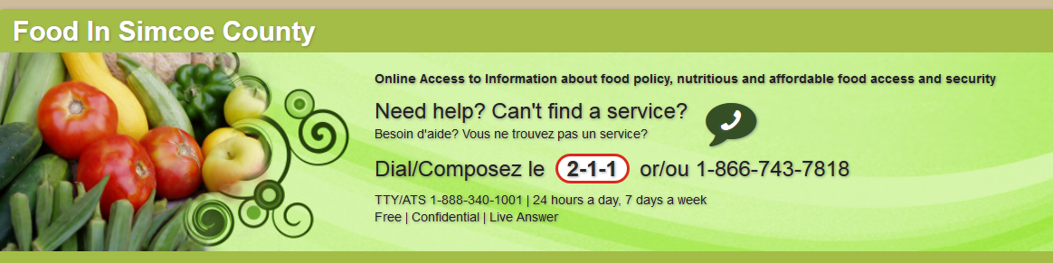




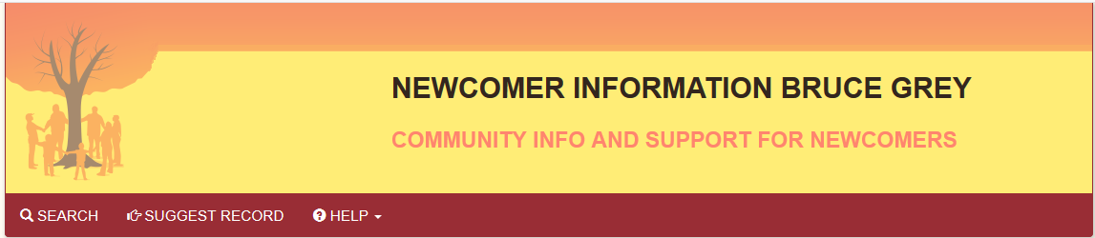


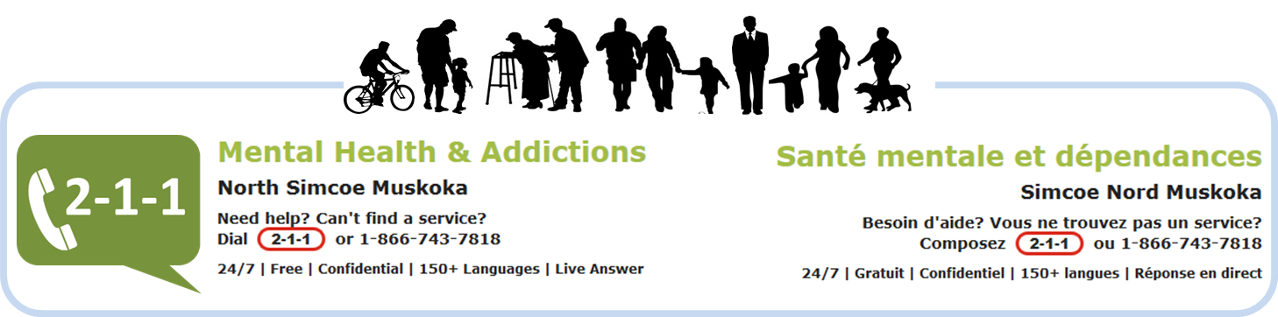

Notes:
We have deep and expansive partnership across many sectors

Slide 24
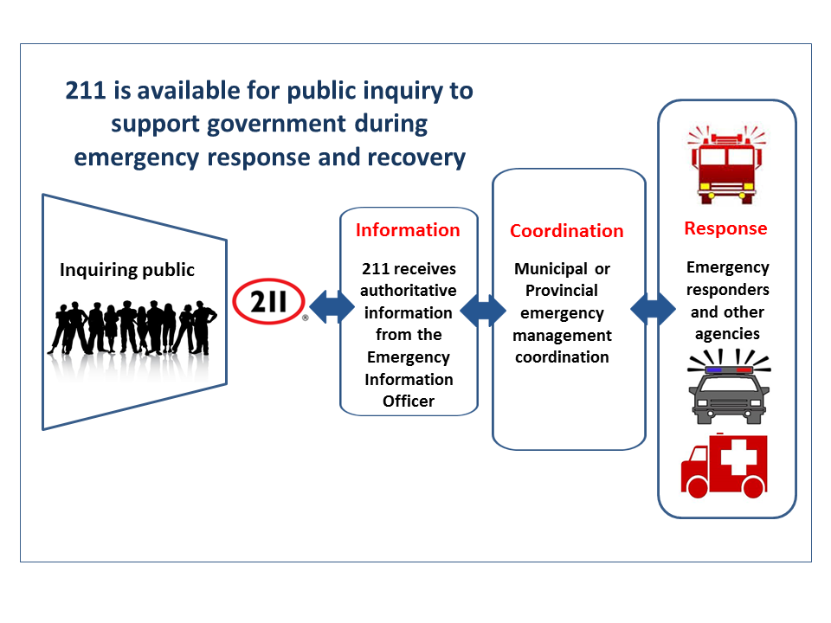
211 in Emergency/Disaster Response

Slide 25
211 & Primary Care eReferrals
Now expanded to six Family Health Team (Collingwood, Barrie, Orillia, Muskoka (2) and two Community Health Centres (Wasaga Beach, South East Grey)
Notes:
A partnership example

Slide 26
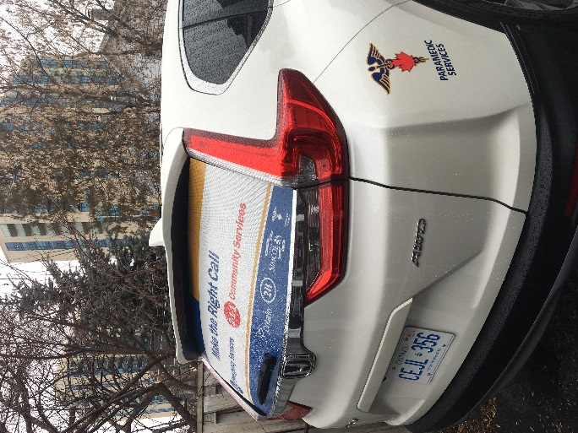
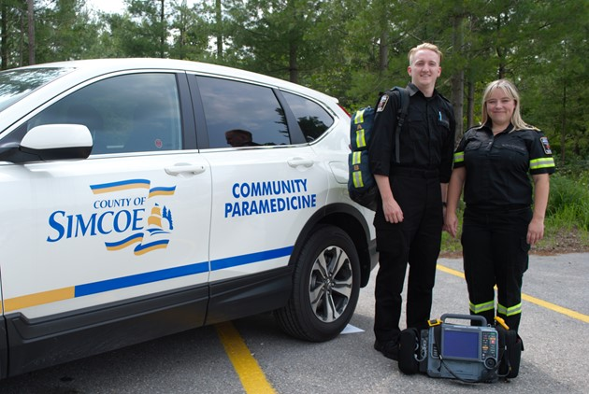
211 & Simcoe County Community Paramedicine
1,644 referrals to 211 over 18 months with 50% of contacted patients receiving more services
Notes:
A partnership example

Slide 27

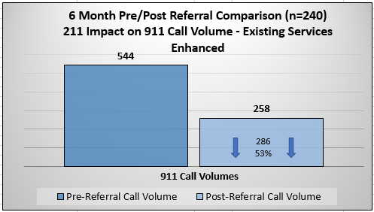
Reducing repeat calls to 911
Notes:
211 reduces unnecessary repeat call to 911

Slide 28
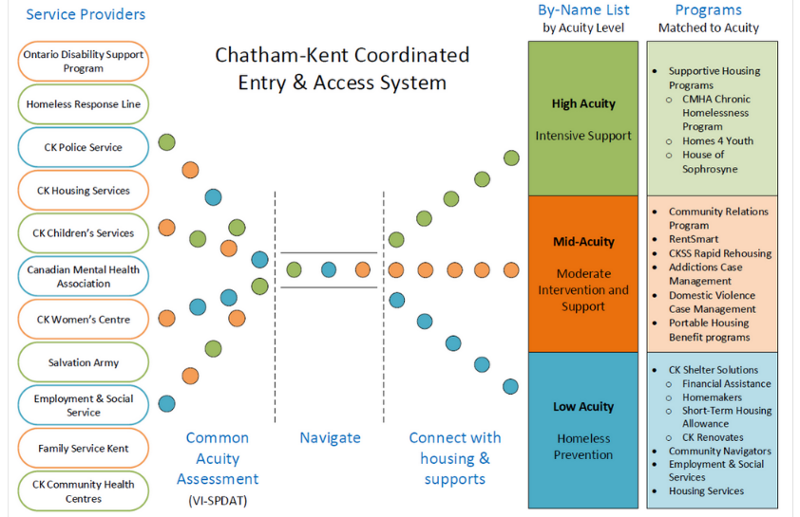




Notes:
New roles in homelessness services in Simcoe

Slide 29

Slide Deck Prepared by:
Pamela Hillier, Executive Director
Community Connection/211 Central East Ontario phillier@communityconnection.ca

