Slide 1
FORUM JUNE 19, 2019

Slide 2
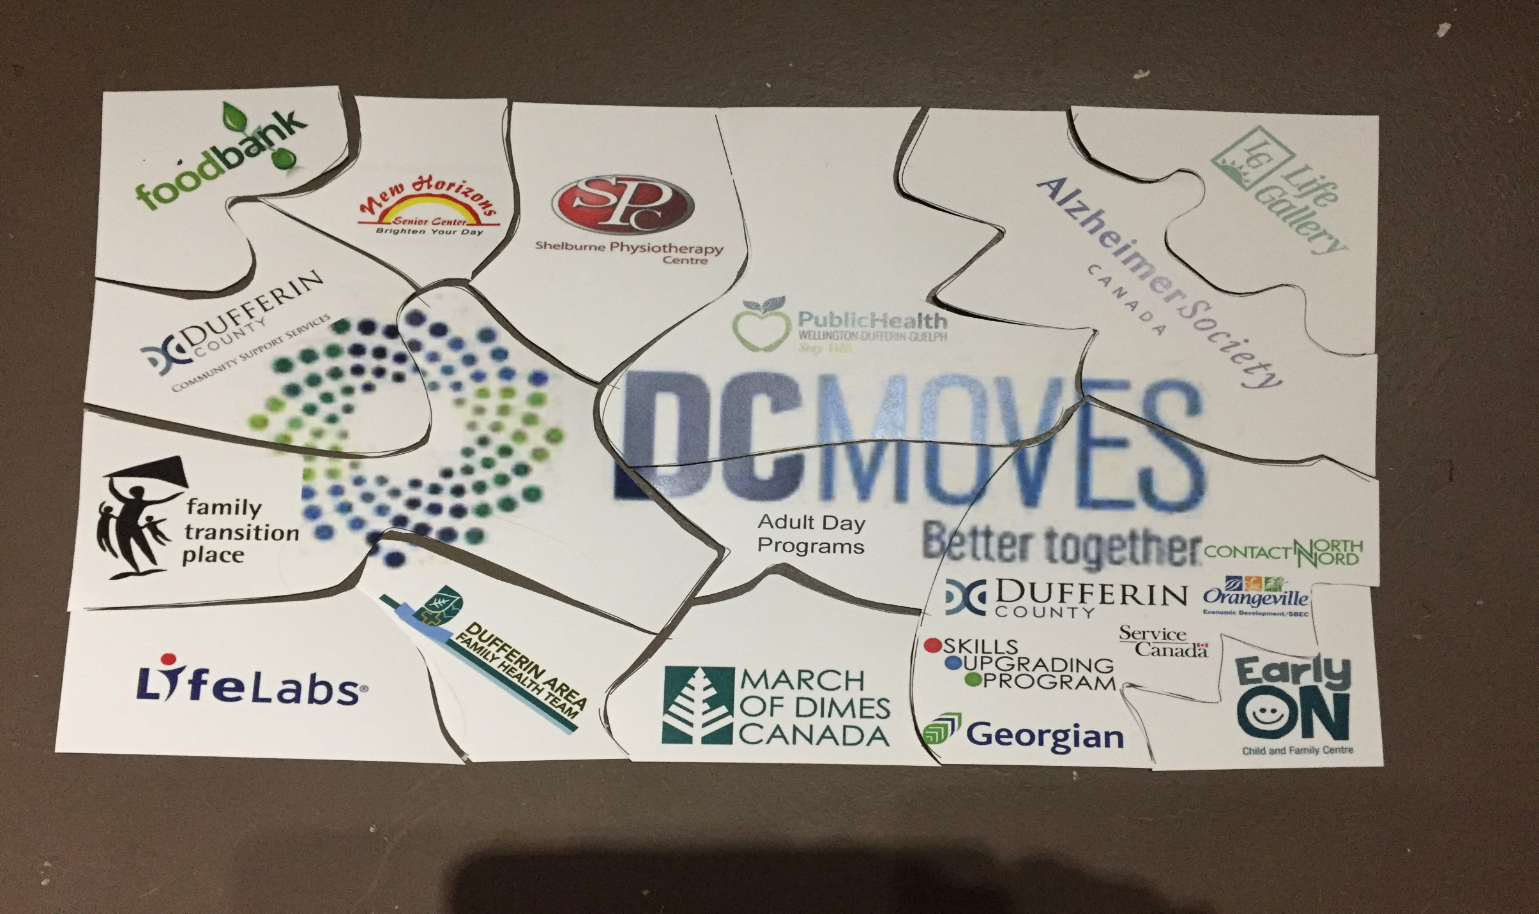

Slide 3


GIVE | GET

Slide 4
  Guest Presenters
  Edify Centre – Sonia MacDonald with Brian McFadden
  Recreational Respite – Lyndsay Gate
  211 Central East ON – Pamela Hillier, Executive Director Community Connection
  https://drive.google.com/open?id=1Fd1kg0TTRQ5RKbZCc0ba921QpoabMvzb

Slide 5
  Project Updates
  Dufferin Community Foundation – Gord Gallaugher
  SHIP – Evaluation and Research Team

Slide 6
  Who’s in the room ?
  Connection Break – come back at 11:00 ☺

Slide 7
VISION: A community where individuals, associations and institutions recognize their role in leaving no community issue unresolved.
MISSION: We create a platform for fostering collaboration and information and knowledge sharing to benefit the residents of Dufferin County.

Slide 8
GOALS
Generate / foster collaborative opportunities to provide coordinated approaches
Increase community agency capacity
Identify and address service gaps
Notes:
Leaders sit at multiple tables and bring back information to share and consider impacts / possible action thru DC MOVES

Slide 9
Implementing the Mission towards achieving the Goals
across 3 priority areas identified by the human service agency community
Community Wellbeing Poverty Reduction Resource Sharing
Notes:
MISSION: We create a platform for fostering collaboration and information and knowledge sharing to benefit the residents of Dufferin County.
GOALS
Generate / foster collaborative opportunities to provide coordinated approaches
Increase community agency capacity
Identify and address service gaps

Slide 10

Community Wellbeing Poverty Reduction Resource Sharing | Implementing the DC MOVES Mission and GOALS To benefit our Residents | What’s on the MOVES Every 1st and 3rd Friday FORUMs quarterly Sponsored workshops Supporting the 3 priority areas Leadership Table

Slide 11
What’s on the MOVES
  participating organisations increasing
  CC distribution increasing
  Open rates above industry standards
FORUMs quarterly
  Avg attendance 30 to 40
  3 agency introductions, 3 project updates
Sponsored workshops – January Capacity Building w/s and 3 L&L webinars, Strategic Planning 101 – rebooked for fall 2019
Notes:
Use these as polling questions in WOTMs

Slide 12


Slide 13
Mid year review (Dec 13 to June 13)
VISION: Every resident of Dufferin County will have the opportunity to realize their potential.
MISSION: A collaborative broad base of stakeholders who are working together to improve the quality of life of Dufferin County residents.

Slide 14




 | EMPLOYMENT
  ACTION: Connect with Workforce Planning Board Waterloo Wellington Dufferin and local Economic Development officers on groundwork and research what others are doing including Dufferin Board of Trade, the Peel Halton Workforce Development Group, Ec Dev Steering Committee, etc.
Working group members: WWD WFP, DC Ec DEV, Humber, Georgian, DBOT, SPEC, LHIN, HHCC, UW, SHIP
Top 3 actions:
Held two data sharing meetings connecting with work being done by WWD WFP, DC ECDEV, DBOT, SBEC. Validated and updated understanding about our Employment challenges and needs
Created awareness across the group about projects and activities in progress regarding Employment and opportunities to leverage each others work to improve outcomes for employees and employers
Able to build on WFP Committee Dufferin work, updating the plans previously drafted with new information, preparing for moving forward with strategies and actions

Slide 15
 | EMPLOYMENT
Stories of Success: (i.e. new connections, a changed practice, greater awareness, increased will)
Reconnected with those previously at the table under Dufferin WFD Committee, increased awareness of what is happening in DC across a broad spectrum
Greater collective understanding of the miss-matched expectations by both employees and employers as well as updating DC stated challenges based on new data
Rejuvenated will to work together to address employment from a collective perspective knowing what each party is doing and how we can leverage each others work

Slide 16

 | HEALTH EQUITY
ACTION: Develop and deliver health equity training(s) - To build capacity and raise awareness of local health equity issues
Working group members:
Heather Hayes, Orangeville Foodbank
Maureen Riedler, Hospice Dufferin
Andrea Noorani, Friends & Advocates, Peel
John Oosterhof , Community Member
Wendy Taylor-Brett , CW Local Health Integration Network
Julie Vanderwerf, Community Services, Dufferin County
Top 3 actions:
1. Health Equity workshops scheduled:
Treating Patients with C.A.R.E. and the Empathy Effect-June 4
Bridges Out of Poverty –September 16
GW Task Force to Eliminate Poverty with Community Members speaking to lived experience-Fall 2019
CW LHIN & William Osler Health System -Fall 2019
Leslie Barnes, Services and Housing in the Province
Heidi Vanderhorst , Dufferin Family Health Team
Tim Smith ,CMHA, Peel
Mary Wheelwright , Headwaters Health Care Centre
Elaine Capes, Coordinator, DCEC
Dave Pearson, CW Local Health Integration Network

Slide 17
 | HEALTH EQUITY
2. Communication: Development of Health Equity messages
3. Promotion/informing: Developed and implementation of social media accounts, Join-In and updated website
Stories of Success: (i.e. new connections, a changed practice, greater awareness, increased will)
Awareness of the work that is currently being done in other agencies/organizations/ community
  Pilot project underway in Brampton/palliative care and working with vulnerable populations
  Poverty simulation exercise- Arthur –Fall 2019
  Organizations use of the Health Equity Impact Assessment (HEIA)
  Moving forward: Discussions to review current barriers that exist in Dufferin by engaging and working with and listening to members of the community with lived experience

Slide 18
 | HOUSING & HOMELESSNESS
ACTION: Investigate collaborative solutions for mixed housing with mixed living/sharing arrangements for different client groups, recognizing that it may involve zoning, joint planning, pooling dollars, building business cases and seeking grants (i.e. Golden Girls, etc.)
Working group members:
United Way, Dufferin County Community Services, DC MOVES, Community Member John Oosterhof, SHIP, Central West LHIN
Top 3 actions:
1. Golden Girls presentation to sub-group on June 6th
2. Creation of a list of considerations to be submitted to the consultant WSP for the Official Plan update as part of the Municipal Comprehensive Review
3. Brainstorming of potential future actions and areas where further investigation is needed

Slide 19
 | HOUSING & HOMELESSNESS
Stories of Success: (i.e. new connections, a changed practice, greater awareness, increased will)
New connection of Dorothy from Golden Girls. She will be able to spread information about homesharing to a larger audience.

Slide 20
http://dcmoves.org/

Slide 21


DCEC & Getting to Impact
May 2019

Slide 22
GETTING TO IMPACT CAPACITY-BUILDING PROGRAM
Vibrant Communities (VC) from the Tamarack Institute for Community Engagement invited us to take part in a learning opportunity to develop a community impact report
The Getting to Impact coaching series provides a high-level framework to assist with organizing and understanding poverty and poverty reduction, and to effectively measure and communicate the impacts of poverty reduction efforts to local stakeholders. The program includes six modules:
    Module 1: Foundations of Measurement
    Module 2: Shifting Awareness & Culture
    Module 3: Nudging Systems & Policy
    Module 4: Programmatic Innovations
    Module 5: Population Level Change
    Module 6: Communicating Results

Slide 23
Evaluation Link ☺
Thank you !

