Slide 1
DC MOVES – Poverty Pillar Update
March 20, 2019

Slide 2
Background
Poverty Summit November 2015
Engagement and Discussion local level 2016
Collaboration between County and HCIA 2016
Creation of DC MOVES 2016
Reducing Poverty in Dufferin County: A Proposed Strategic Framework Feb 2017
Research
Discussion
Strategic
Priorities
DCPRTF 2017/2018
Local Health Integration Network – Poverty Working Group 2018
Notes:
Discuss the history… the Dufferin County Poverty Reduction Taskforce (DCPRTF) formed following Poverty forum as part of one of the DC MOVES pillars.
Reducing Poverty in Dufferin County: A Proposed Strategic Framework Feb 2017 for results
LHIN Poverty Sub Collaborative etc 5
Poverty Summit November 2015
Engagement and Discussion local level 2016
Collaboration between County and HCIA 2016
Creation of DC MOVES (Dufferin County Managing Organizing Validating Engagement Strategies) 2016
Reducing Poverty in Dufferin County: A Proposed Strategic Framework Feb 2017
Research/discussion/strategic priorities for Dufferin County Poverty Reduction Task Force (DCPRTF) 2017/2018
Local Health Integration Network – Poverty Working Group 2018

Slide 3
How we arrived at Today
Duplication between DCPRTF and LHIN Poverty Working Group
Better Information sharing, data collection and planning if tables are combined
Sub Committee formed to create new Terms of Reference for new combined group
Demonstrate cross sectoral support (County and Public Health Co-Chair)
Reframed ‘Poverty’ to ‘Equity’
Build on the work already done by both tables and create draft Road Map

Slide 4
Collaboration……. Collaboration……. collaboration
‘Intersectoral collaboration is essential to addressing complexities of social, political, economic and environmental factors that influence… inequities’
(Jeffrey Turnbull, 2018)
No one can do this work on their own
Many levers of change on determinants of health lie outside the health sector
Collaboration includes, clients, patients and families
Notes:
Dr. Turnbull is a physician in Ottawa working with the Ottawa Inner City Drug replacement program – harm reduction – sees the most marginalized patients in his city.
Why?
Many levers of change on determinants of health lie outside the health sector
Not one of us can do this work on our own
Collaboration includes patients and families as well

Slide 5
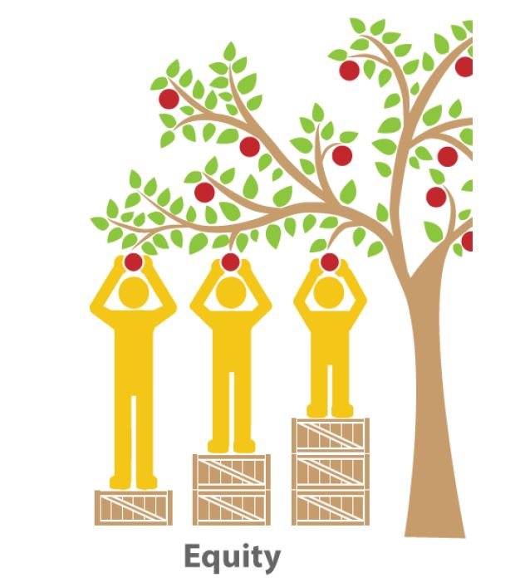
Equity Definition
“Equity means that all people can reach their full potential and are not disadvantaged from attaining it because of their race, ethnicity, religion, gender, age, social class, socioeconomic status or other socially determined circumstance.”
(Whitehead & Dahlgren, 2006)
(Image source: Saskatoon Health Region, 2017)
Notes:
Definition to give context and ground

Slide 6
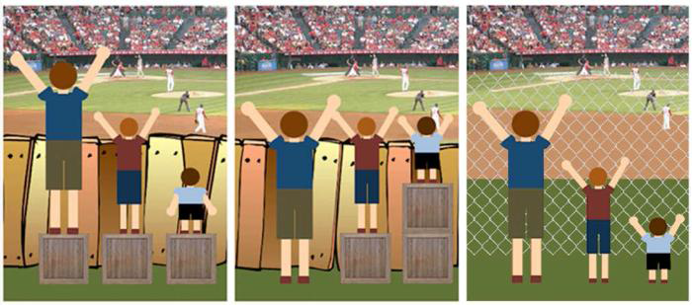
Equality Versus Equity
Notes:
Equality vs Equity

Slide 7
New Terms of Reference
Purpose
Guiding Principles
Decision Making Process
Membership
Role of Members
Role of Co-Chairs
Role of Coordinator
Conflict of Interest
Meetings

Slide 8
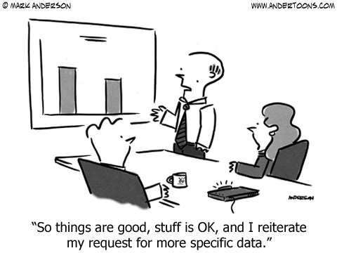
How did these Priorities Emerge – Data Snapshots
Multiple sources of data and evidence
Building upon previous planning and reports

Slide 9
Community Priorities for Roadmap
  Housing and Homelessness
  Employment
  Health Equity
  Evolving Community Priorities to Monitor:
    Aging in Place
    Early Childhood Development
    New to Dufferin
Notes:
We reached these areas of focus/community priorities by looking at current data as well as reviewing past priority areas and other work taking place in the community.
Key Considerations:
Avoid duplication
Look at current data
Wanted to identify gaps – no one is doing the work
Stay focused – understand that there is a lot of work and we only have so much capacity so we need to only do some priorities ta the start but do them well

Slide 10
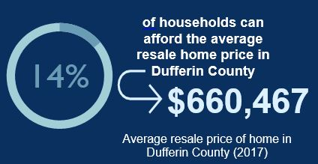
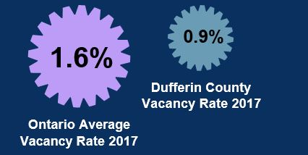
Housing and Homelessness
The average resale price for homes within Dufferin have risen substantially over the past decade; however, incomes are not rising quickly enough to meet these increasing prices.
There is also an insufficient availability of rental units in Dufferin as well.
Real Property Solutions (RPS), 2017
Rental Market Survey (RMS), 2017, Canada Mortgage and Housing Corporation
Notes:
Housing in a community is generally deemed to be inadequate if it is: not properly designed, poorly located, is not safe and secure, is not affordable, is not accessible and is not available. In Dufferin County, the two obvious barriers to housing are availability and affordability.

Slide 11
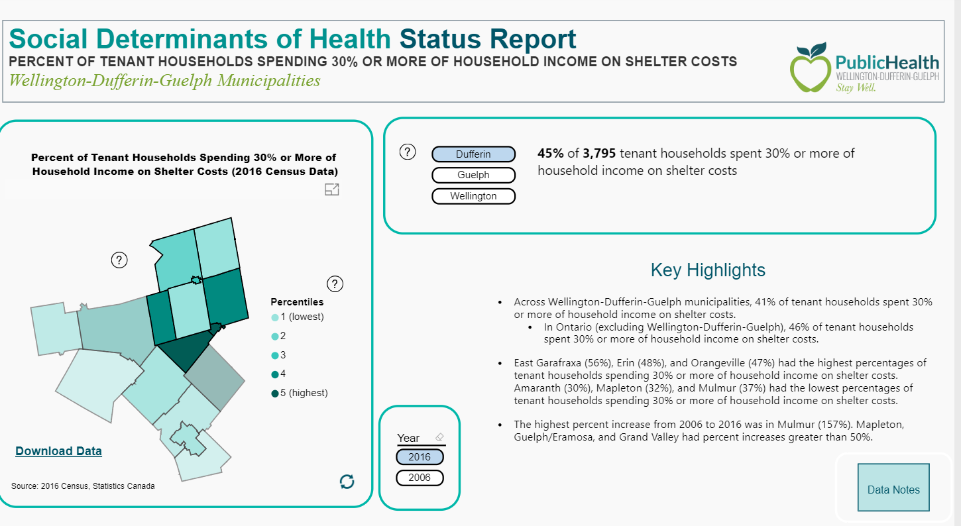
Housing and Homelessness – Tenant Households
45% of tenant households in Dufferin County spend more than 30% of their household income on shelter costs.
Notes:
In Canada, housing is considered affordable if the cost is less than 30% of before tax income. In Dufferin County, 45% of tenant households are not affordable.

Slide 12
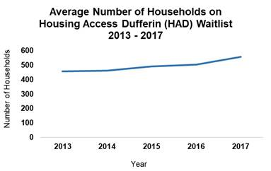
Housing and Homelessness - Waitlist
Total Number of applicants on Housing Access Dufferin* Waitlist (as of Q3 2018): 652

Slide 13
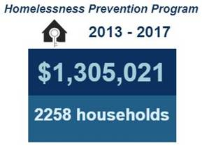
Housing and Homelessness - Prevention
HOMELESSNESS PREVENTION PROGRAM
Number of Clients served in Q3 2018: 146
Notes:
Housing is often viewed as a neatly divided issue: one is either homeless or housed; however, this does not take into account the precarious housing situations that people, especially vulnerable populations, may experience. These in-between states of housing include residing in homeless shelters, living in doubled- and tripled-up circumstances with multiple families in one unit and staying on friend’s couches, and moving frequently between places
The Homelessness Prevention Program (HPP) is a comprehensive, year-round emergency financial assistance program administered by Housing Services. All programs under the HPP umbrella aim to help households maintain or obtain affordable accommodation. Eligible expenses may include first and last month's rent deposits, rent and utility arrears. Other housing-related expenses may be considered, such as moving and storage, or emergency needs for people who are homeless. HPP tries to assist those that are currently homeless and helps to prevent others from becoming homeless.

Slide 14

Employment
‘Employment provides income, a sense of identity and helps to structure day-to-day life’ (Raphael, 2015).
Multiple layers to this priority:
  Education and Training
  Types of Employment
  Income
Notes:
Employment provides income, a sense of identity and helps to structure day-to-day life. Unemployment frequently leads to material and social deprivation, psychological stress, and the adoption of health-threatening coping behaviours.
We know that employment is important from purely an economic perspective, but it is a complicated priority with many layers.

Slide 15
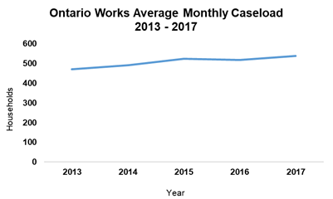
Employment – Ontario Works
SOCIAL ASSISTANCE (ONTARIO WORKS)
Average Monthly Caseload as of Q3 2018: 643
Notes:
Ontario Works provides income and employment supports to people in financial need. People receiving financial assistance through Ontario Works participate in a wide range of employment assistance activities, which help them, prepare for, find and retain employment. The amount of financial assistance a person receives will vary depending on family size, income, assets and shelter costs.

Slide 16
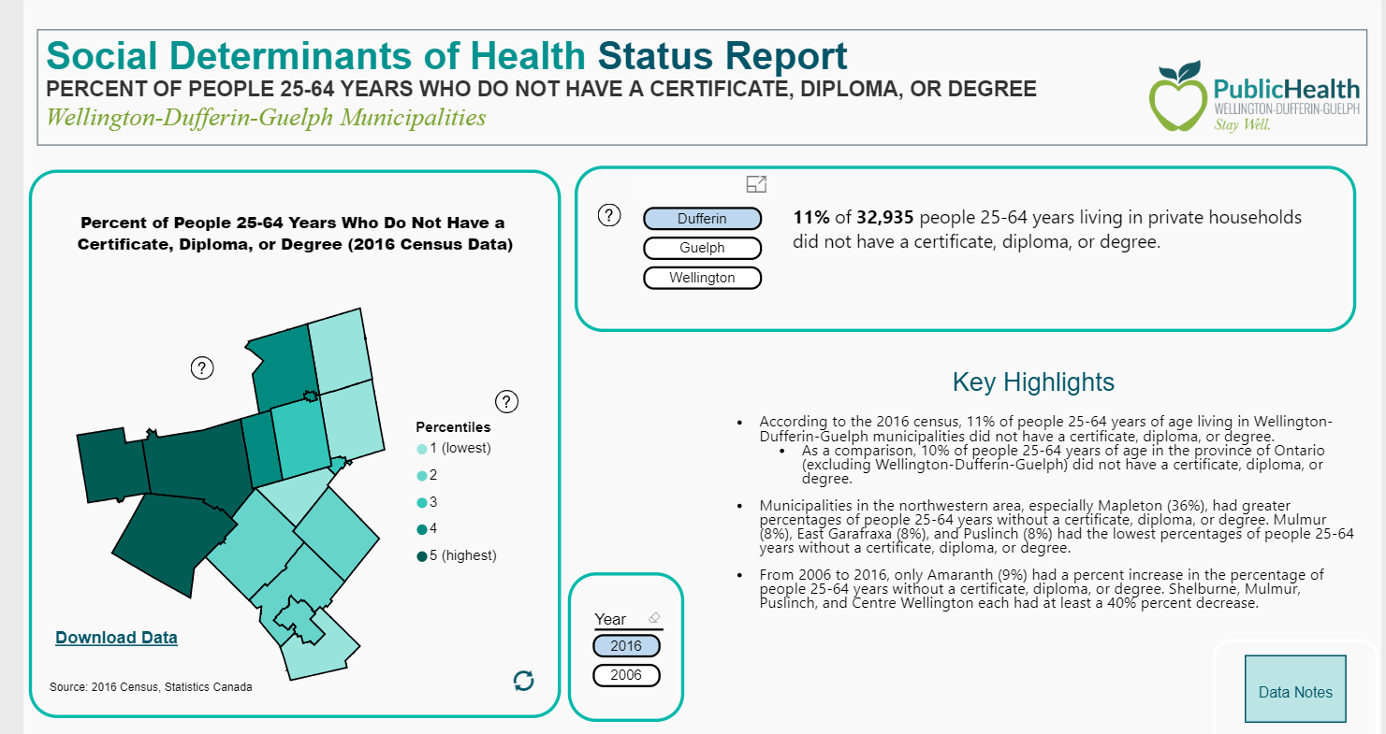
Employment - % of people 25-64 years with no certificate, diploma or degree
11% of individuals 25-64 years with no certificate, diploma or degree
Higher in Grand Valley, Melanchthon and Shelburne
Notes:
11% or Approx. 3620 of 25-64 year olds

Slide 17
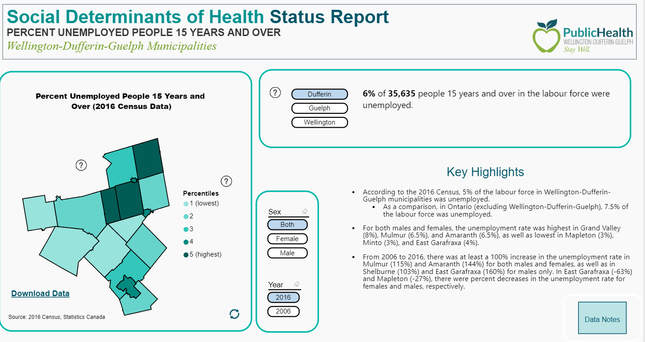
Employment – Unemployment Rate
6% unemployment rate for individuals 15 years and over
Higher in Grand Valley, Amaranth and Shelburne
Higher among females
Notes:
6% Unemployment Rate =Approx 2200
Discuss type of work, i.e. part time, precarious, contracts, low wages – individuals that are working are still using emergency food services, accessing social services

Slide 18
Health Equity
Health Equity – All individuals can reach their full health potential and there are not disadvantaged from attaining it due to social, economic factors.
‘Health is unevenly distributed between social groups in the population’ (Norwegian Ministry of Health and Care Services, 2007).

Slide 19
Health Equity – Food Insecurity
Income Scenario | % income required for rent | % income required to purchase the NFB | Total % of income required for rent and the NFB | $ left for all other expenses
Median Ontario income | 15% | 12% | 27% | $5761.31
Family of Four on OW | 46% | 35% | 81% | $472.31
Single person on OW | 93% | 38% | 131% | (-$247.10)
Proportion of households experiencing food insecurity in Wellington-Dufferin-Guelph was approx. 14% (Canadian Community Household Survey, 2012-2014).
Notes:
Proportion of households experiencing food insecurity in Wellington-Dufferin-Guelph was approx. 14%. (statistically significant stat)
Proportion of households experiencing food insecurity in Dufferin is estimated to be 15%. (Caution: High sampling variability with this estimate)
In Ontario, the proportion of households experiencing food insecurity is approximately 12%
WDG:
Marginal 5%
Moderate 6%
Severe 3%
Ontario
Marginal 3%
Moderate 6%
Severe 4%
Food Insecurity: is defined as inadequate or insecure access to food because of financial constraints.
MARGINAL FOOD INSECURITY
Worry about running out of food and/or limit food selection because of lack of money for food.
MODERATE FOOD INSECURITY
Compromise in quality and/or quantity of food due to a lack of money for food.
SEVERE FOOD INSECURITY
Miss meals, reduce food intake and at the most extreme go day(s) without food.

Slide 20
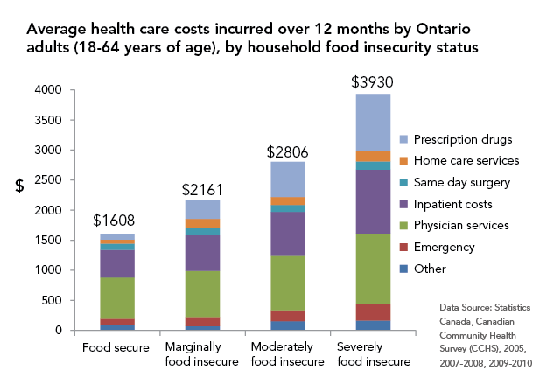
Health Equity – Food Insecurity and Healthcare Costs

Slide 21
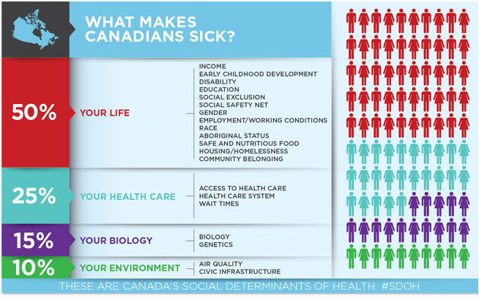
Health Equity - Income
Canadian Medical Association, 2013)
Notes:
‘The primary factors that shape the health of Canadians are not medical treatments or lifestyle choices but rather the living conditions they experience’ (Raphael, 2010).
Low income households – 9% in Dufferin living in Low income households, higher in Melancthon, Grand Valley and Shelburne

Slide 22
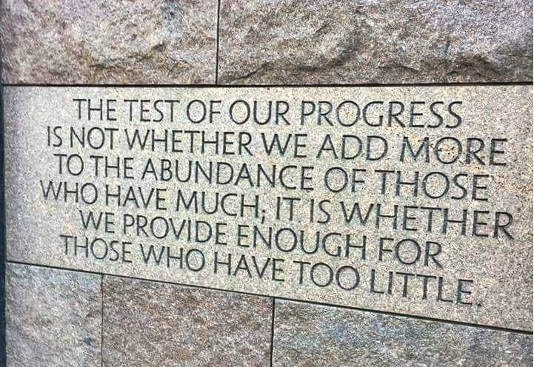
Thank you for your time.

