Slide 1
DCEC & Getting to Impact
May 2019

Slide 2
GETTING TO IMPACT CAPACITY-BUILDING PROGRAM
Vibrant Communities (VC) from the Tamarack Institute for Community Engagement invited us to take part in a learning opportunity to develop a community impact report
The Getting to Impact coaching series provides a high-level framework to assist with organizing and understanding poverty and poverty reduction, and to effectively measure and communicate the impacts of poverty reduction efforts to local stakeholders. The program includes six modules:
Module 1: Foundations of Measurement
Module 2: Shifting Awareness & Culture
Module 3: Nudging Systems & Policy
Module 4: Programmatic Innovations
Module 5: Population Level Change
Module 6: Communicating Results

Slide 3
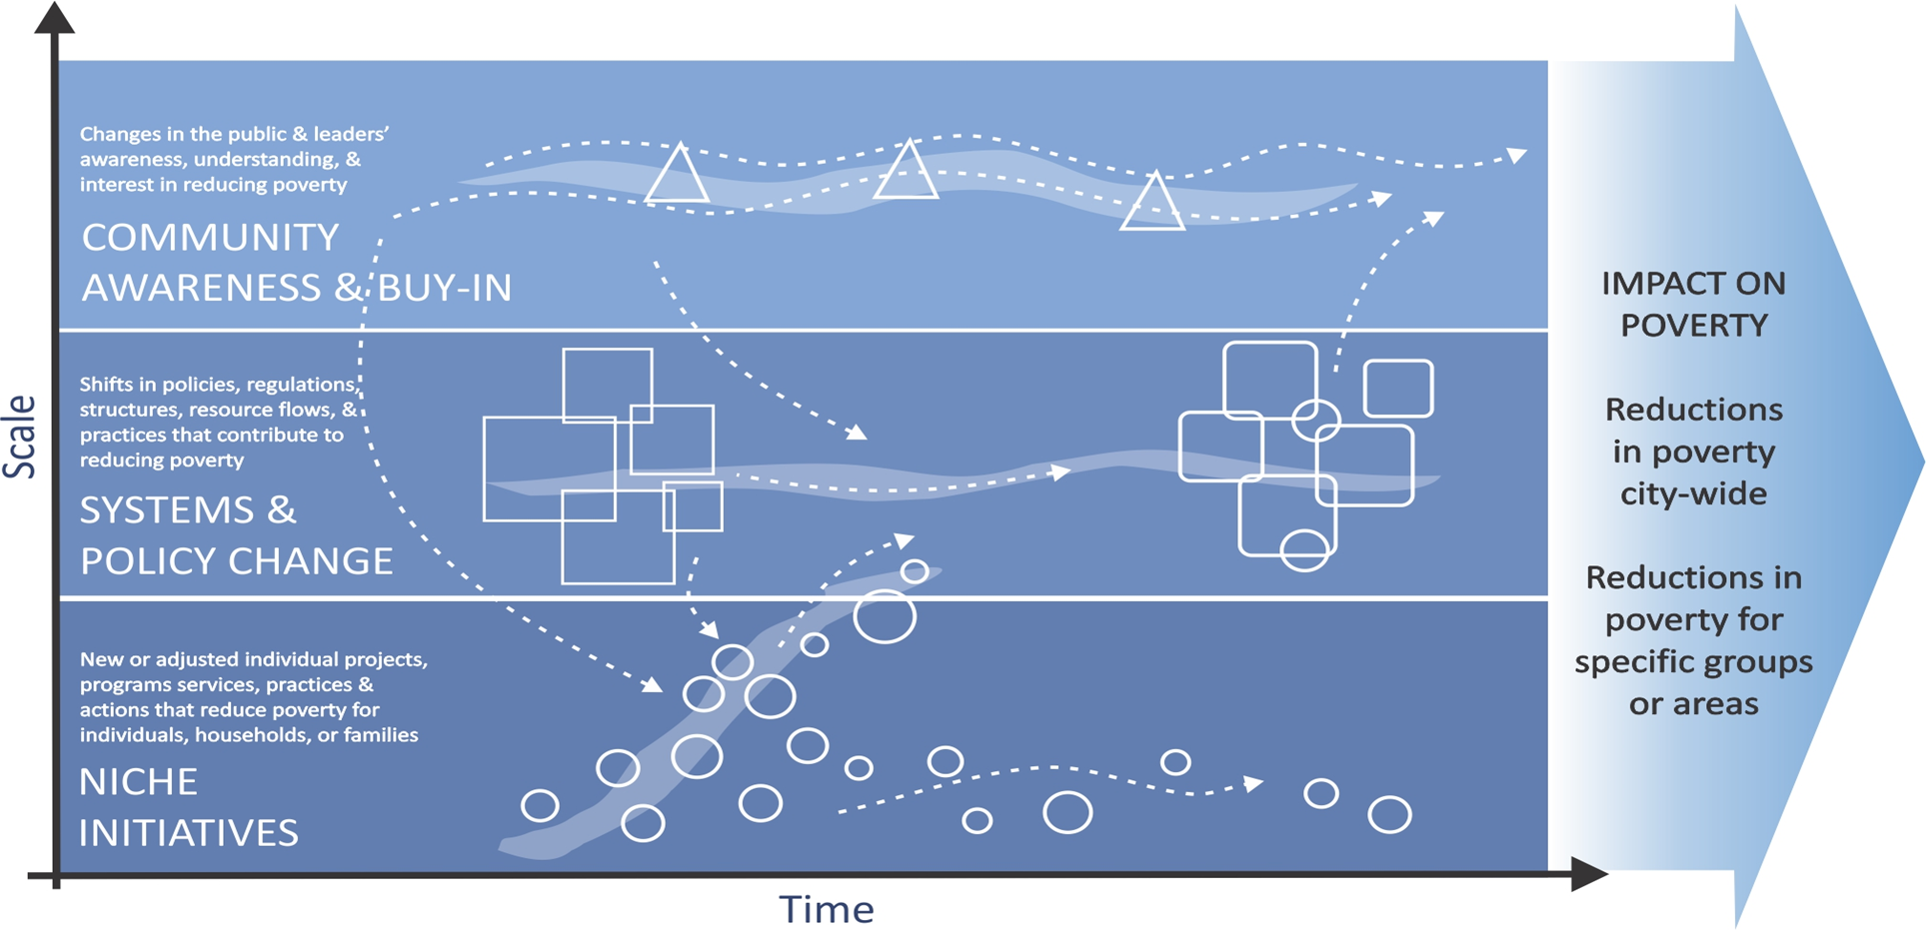
THEIR FRAMEWORK
Outcomes
Impact

Slide 4
OUR FRAMEWORK
 | ADVOCATING & INFORMING Champion and give voice to the need for system and policy changes that reduce inequities Inform stakeholders and decision-makers about local needs and priorities to influence policy and service design, delivery and evaluation
 | MINIMIZING SERVICE BARRIERS Provide service from a system lens Understand service access through a client (patient, etc.) perspective Responding (to needs and designing system accordingly) from client perspective
 | INNOVATING SOLUTIONS Evidence informed planning and decisions Action Orientated Recognise and act on opportunities to make immediate change to improve service access

Slide 5
THEIR FRAMEWORK + OUR FRAMEWORK
OUTCOMES
Housing & Homelessness
Employment
Health Equity
 | ADVOCATING & INFORMING (AWARENESS & BUY-IN) Champion and give voice to the need for system and policy changes that reduce inequities Inform stakeholders and decision-makers about local needs and priorities to influence policy and service design, delivery and evaluation
 | MINIMIZING SERVICE BARRIERS (SYSTEMS & POLICY CHANGE) Provide service from a system lens Understand service access through a client (patient, etc.) perspective Responding (to needs and designing system accordingly) from client perspective
 | INNOVATING SOLUTIONS (NICHE INITIATIVES) Evidence informed planning and decisions Action Orientated Recognise and act on opportunities to make immediate change to improve service access
IMPACT ON EQUITY
Every resident of Dufferin County will have the opportunity to reach their full potential.
SCALE
TIME

Slide 6
DEFINITIONS
IMPACT: The effects of outcomes that contribute to vision (e.g., reduction of poverty, increase in equity for Dufferin County residents)
OUTCOME: Actions, behavior changes by key system actors (e.g. policy change, new investments, changed decision-makers) that ‘align’ and ‘contribute’ to moving forward on a vision. Changes in public/influencers/decision makers awareness, understanding and interest in equity
TACTICS: What methods are used to create awareness, will, changes in behavior (i.e. Political Will Campaign or Public Forum)
MEASUREMENT: How we measure impact
THEORY OF CHANGE: Advocating & Informing + Minimizing Service Barriers + Innovative Solutions (over time) = IMPACTS ON EQUITY

Slide 7
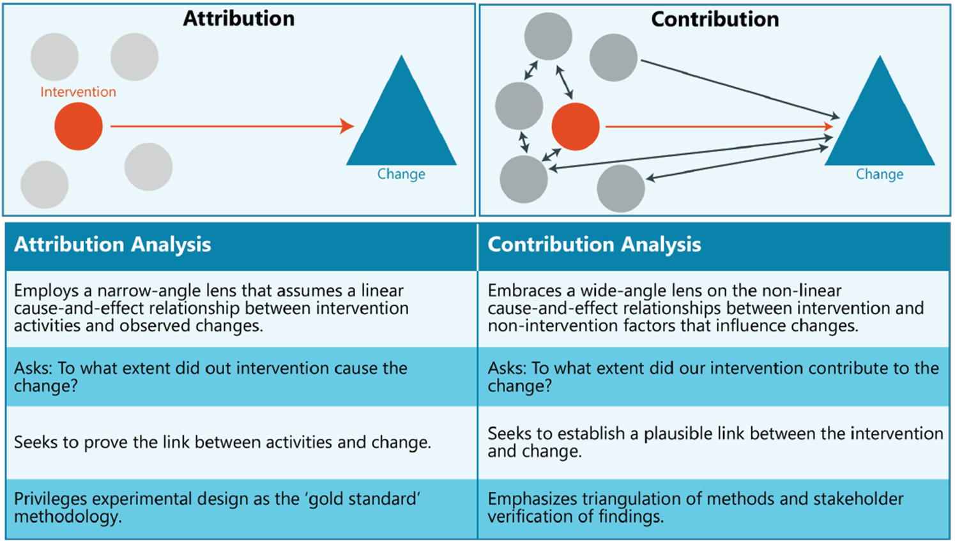
IMPACT – CONTRIBUTION VS. ATTRIBUTION

Slide 8
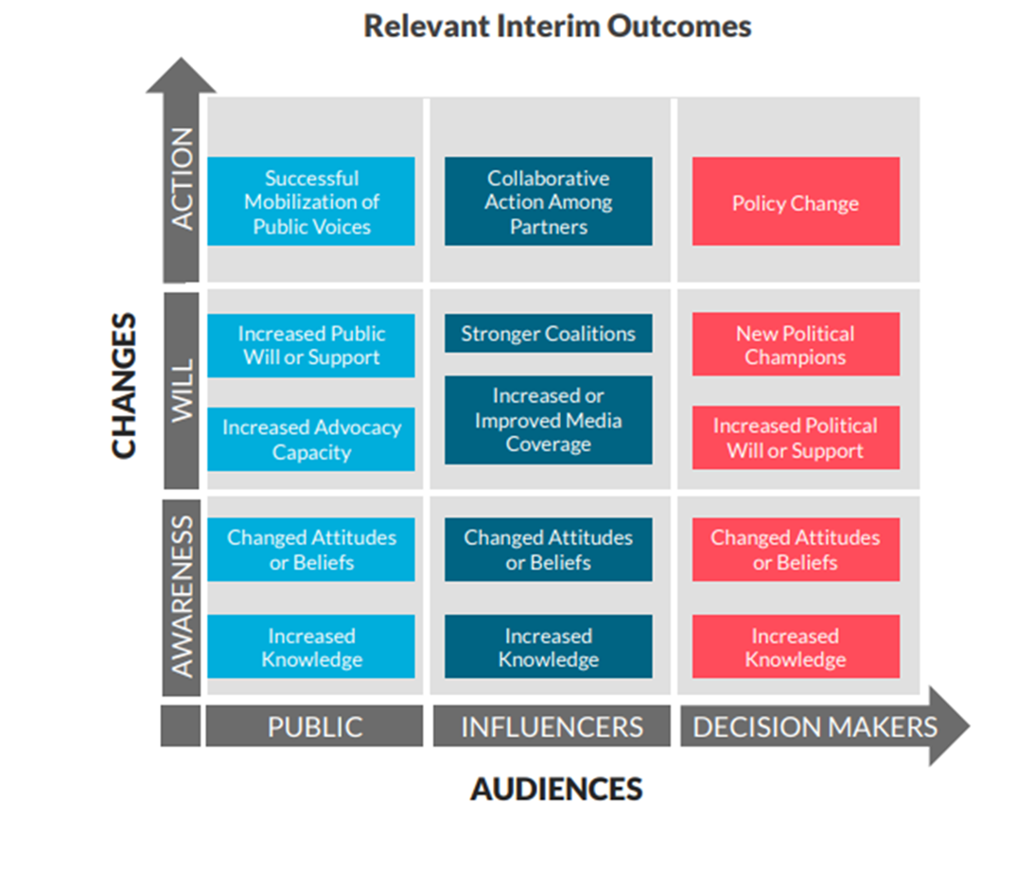
OUTCOMES

Slide 9
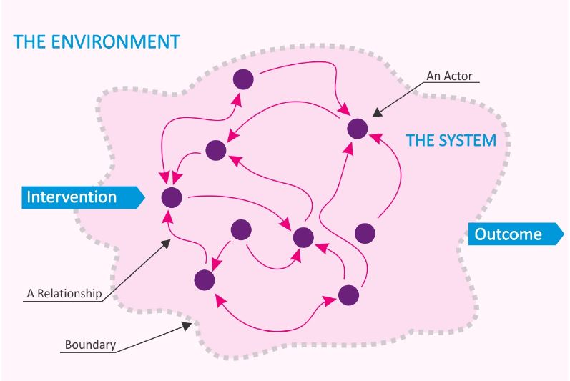
SYSTEMS THINKING
BOUNDARIES: The scope of the system you are seeking to influence
ACTORS: The people and/or organizations that operate within the system
RELATIONSHIPS: The nature of interaction between the actors of the system
LEVERAGE POINTS: Places within the system that can be tweaked (with interventions) to have greater impact on the system (a small amount of change causes a greater impact on overall system)

Slide 10
LESSONS LEARNED SO FAR
12 core principles for measuring community change
Common language & consistency is essential
Contribution vs. Attribution way of thinking
Working through each module is helping us to define, track, collect data and information and shape communication about DCEC outcomes and impact
What are the most urgent and important outcomes and impacts to communicate?
Systems thinking (we are actors within the system)
Leverage points are crucial for systems change
12 CORE PRINCIPLES
Clarify your purpose
Accept imperfection
Align ‘results’ to your plan priorities
Prioritize measurement
Employ mixed methods
Weave together a patchwork of data
Match methods to capacity
Make informed choices
Estimate contribution
Assess value
Make appropriate claims
Learn by doing

